Slide 1
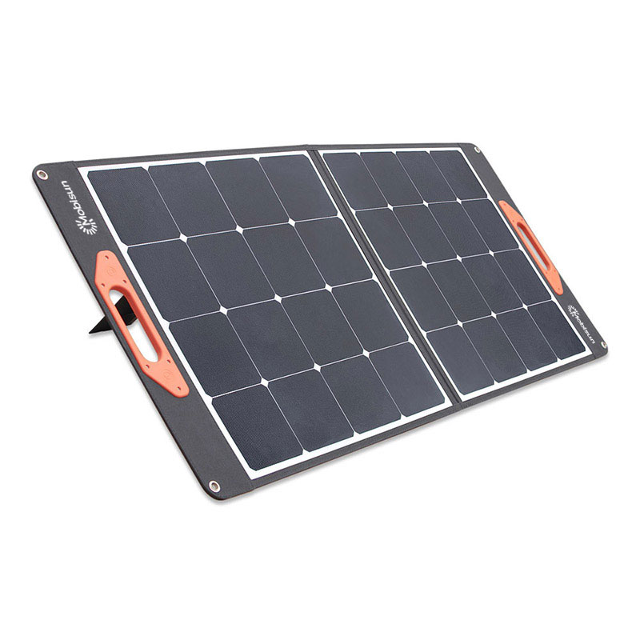
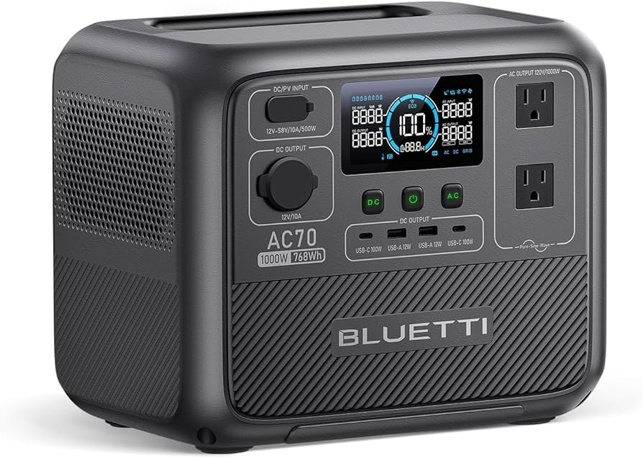
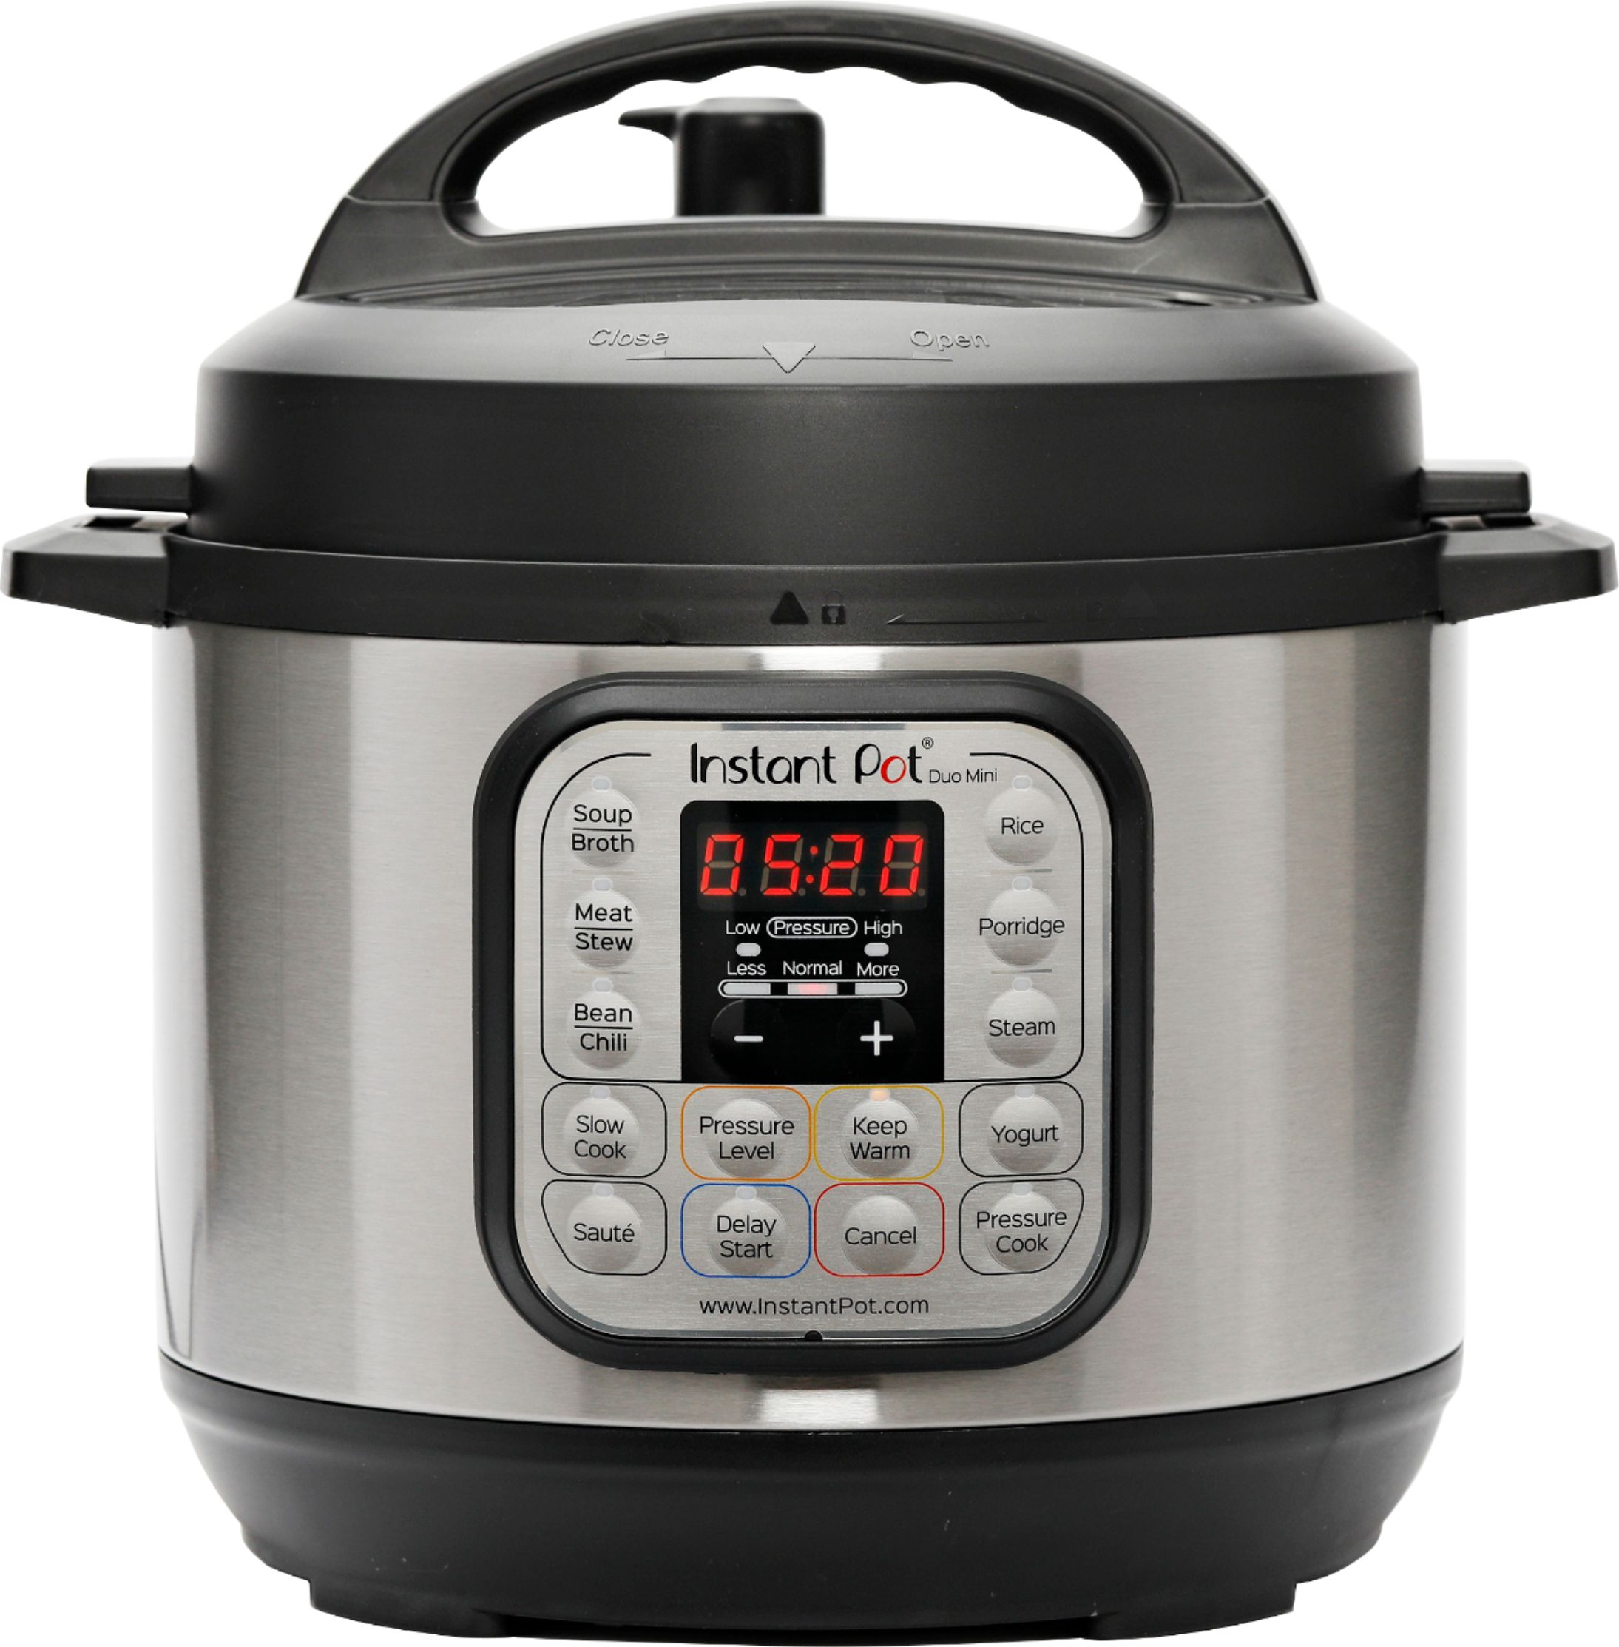
Low Watt Power Station Cooking Updated 2024 Edition
Powering your kitchen in an emergency

Slide 2
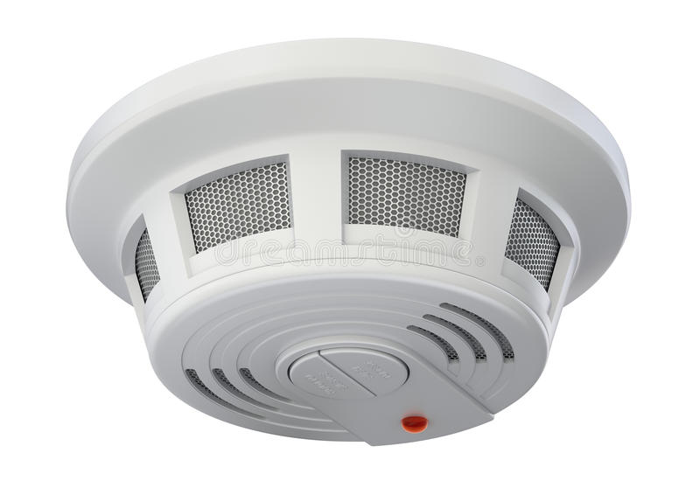
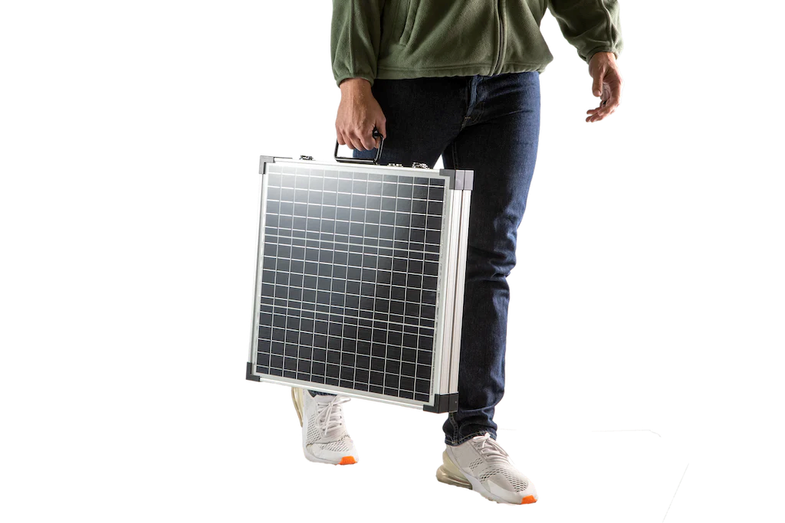
What are the advantages to cooking with a Power Station in an emergency?
SAFETY
No open flames
No Carbon Dioxide or Carbon Monoxide
PORTABILITY
A Portable Power Station (Solar Generator), mini appliances and foldable solar panels are useful in both Bug Out and Bug In scenarios
CONVENIENCE
Electric appliances are often “Set & Forget” – you may well have other things to worry about in a disaster
You can safely cook nearly anywhere, even in a car or tent

Slide 3
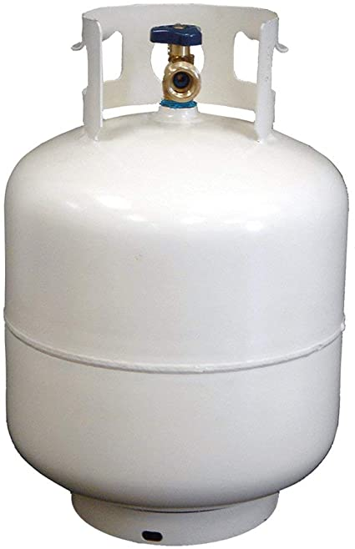
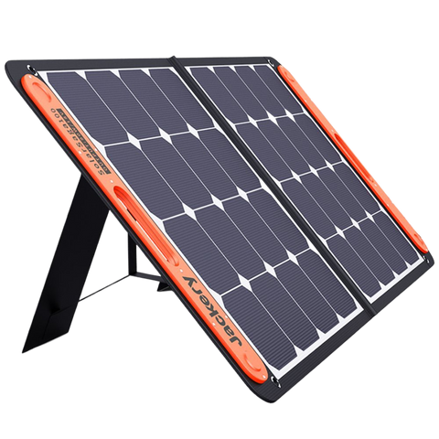
Advantages: (Part 2)
NOT JUST FOR HEATING FOOD
A Portable Power Station can also run: DC fridge, LED lights, blenders, food processors, dehydrators and even a small grain mill to keep you cooking
STEALTHY
No need to cook outdoors, make lots of smoke or trips to gather expendable resources (IF they are available). Often, food smells are more contained too
RENEWABLE
With solar panels you can recharge your Portable Power Station for years, even decades
?
✓
Fuels you can gather locally

Slide 4
What are the disadvantages to cooking with a Power Station?
Small & affordable Portable Power Stations don’t store a lot of electricity so don’t expect to use your full-sized stove top or toaster oven. You can power your whole house with a large enough system but this guide is for the more affordable & portable Power Stations
Since cooking with electricity can use a lot of the stored energy in your Power Station, you will need to “Mind Your Watts” using the tips given here
To get beyond a short-term emergency you will need a way to replace the power stored in your Portable Power Station. For that you will need solar panels, car/truck cigarette lighter plug, generator and/or accessible AC wall plug to recharge

Slide 5
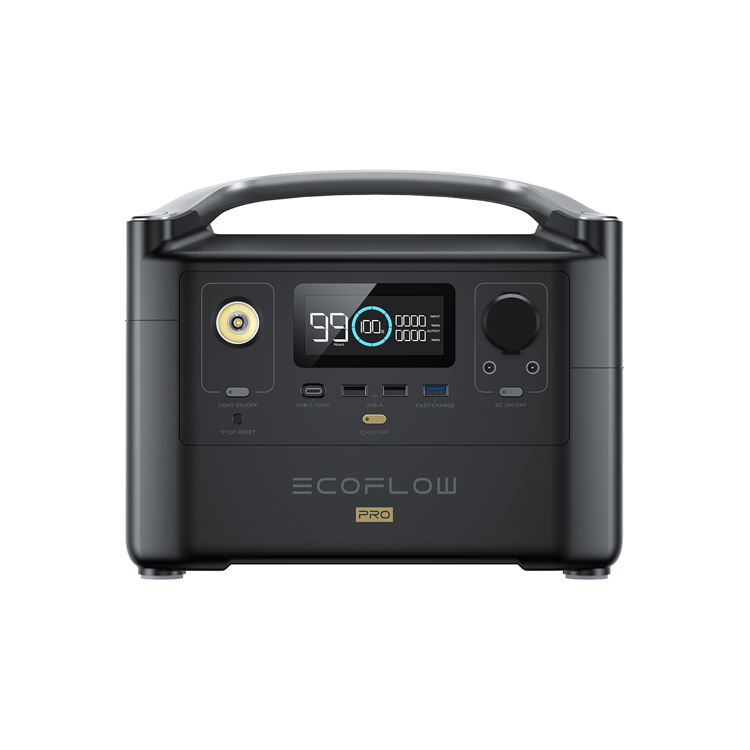
Your Solar Powered Bank Account
Make sure the amount of power you are putting into your Power Station (your “bank account”) at least equals what you draw out & “spend” over time. Remember, with solar panels you literally need to “Save for a Rainy Day”
Your “Income”
Your “Bank Account”
Your “Expenses”

Slide 6
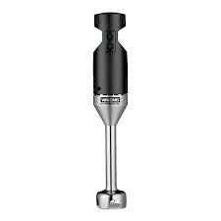
Successful Low Watt Cooking Strategies
Right size your appliances. An immersion blender (200 to 350 watts) will make powdered milk butter just as well as a Vitamix blender (1400 watts)
With no or limited refrigeration is does NOT pay to cook large batches. Cook just what you need for a meal or two
Once charged, your Power Station will ignore the power coming your solar panels. This is the perfect time to use those free incoming watts to cook a meal and still leave your power station topped up

Slide 7
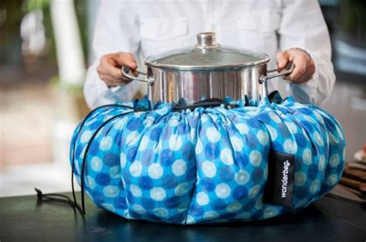
Successful Low Watt Cooking Strategies (2)
Use your Power Station as an alternate to non-renewable ways of cooking (wood/gas/alcohol stoves) to stretch those limited supplies. Cloudy? Cook with gas/wood. Sunny? Cook with electricity and save those scarce combustibles
Store fast cook items. For example, rice & lentils cook much faster (and therefore take much less fuel/power of any kind) than dried beans. Also presoak beans/grains, if possible, to cut cooking time
Heating to a boil & then insulating the pot until it finishes cooking works for electric too. Google “Thermal Cooker” and “Wonderbag” to find out how to cut your power/fuel usage by 50% or more

Slide 8
Power Stations: What Watts Are What?
Here are the 3 Types of Watts you need to know about your Portable Power Station
AC Output Watts (or Inverter Watts): This determines what appliances your Power Station can power. A Bluetti EB70S has an 800 Watt AC Inverter so that is it’s AC output capability. That means it CAN power a 3 Quart Instant Pot (700 Watts) but can NOT power a Vitamix blender (1400 Watts)
NOTE: Some stations offer “Boost/Lifting Mode” which doubles the Output Watts BUT it does this by cutting the voltage. This can DESTROY devices with electronics, motors & compressors – ignore this “feature”, I always turn it off
Stored Watt Hours: This is how much electricity your Portable Power Station can hold. A 1000 Watt Hour Power Station can heat up roughly 21 cans of soup in a mini rice cooker (40 Watt hours x 21 = 840 Watt Hours). The ‘missing’ Watt Hours are AC conversion loss - usually about 15% - so usable Watt Hours are always less
Solar Input Watts: This is how much power, in Watts, your Portable Power Station can receive from a solar panel. The more it can receive the faster you can charge the Power Station and/or pass-through to other devices. You want to be able to fully re-charge your Power Station within 5 hours or less

Slide 9
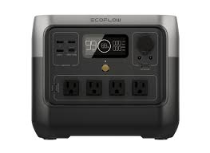
Recommended Minimum Sized Power Station for Cooking?
For low watt cooking and some general use, you will want a Portable Power Station with at least 500 Watts AC Output and 500 or more Stored Watt Hours (examples below)
To renewably recharge your Portable Power Station you will want a solar panel, preferably 100 Watts or more for a small power station and 200 to 300 Watts for a larger one (1000+ Stored Watt Hours)
Folding solar panels are more expensive but more portable in a Bug Out scenario
Bluetti AC70
1000 Watts AC Output
768 Watt Hours Storage
500 Watts Solar Input
Cost $350 to $500
EcoFlow River 2 Pro
800 Watts AC Output
768 Watt Hours Storage
220 Watts Solar Input
Cost $350 to $500

Slide 10
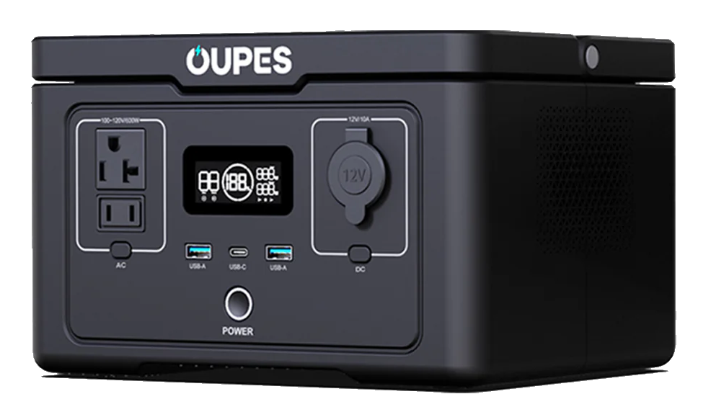
But My Power Station Doesn’t Meet Those Minimum Specs ☹
You can still do low Watt cooking with a Power Station that doesn’t meet the recommended specs, but you need to concentrate on using the lowest Watt appliances and having way to refill the power station as quickly as possible (since you don’t have much battery buffer)
Higher Solar Input Watts means you can replace power more quickly & directly power appliances via solar - a BIG feature on a small Power Station
Utilize the strategy of only cooking when you are sure you can replace the power through solar, generator or car charging. Keep those Watts in reserve!
OUPES 600 Exodus
600 Watts AC Output
256 Watt Hours Storage ☹
240 Watts Solar Input ☺
Cost About $140

Slide 11
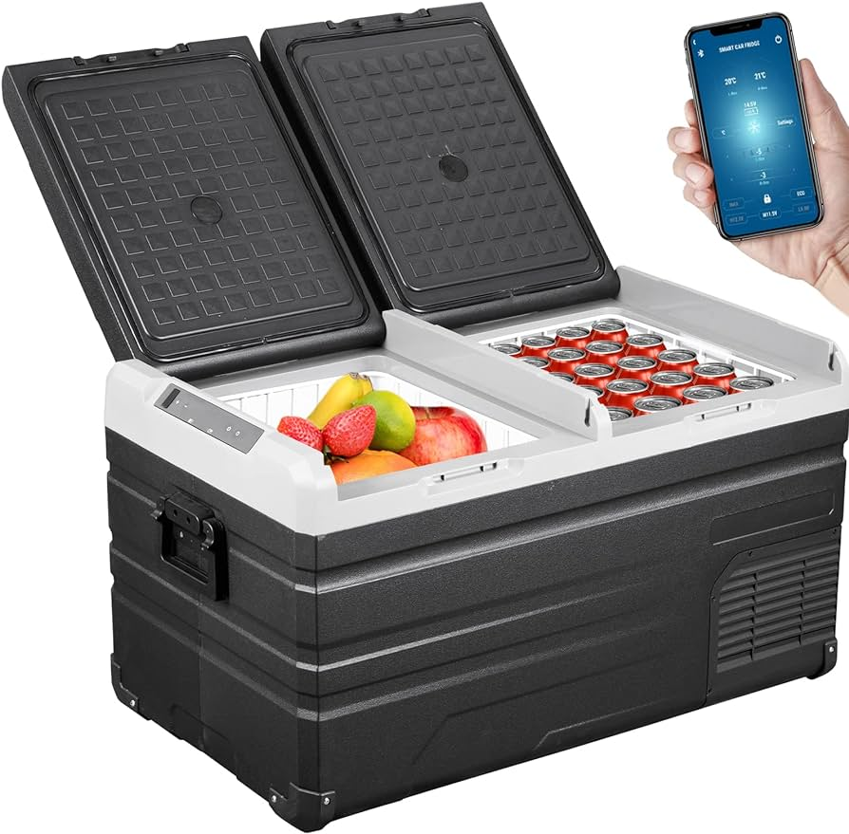
Low Watt Cooling
Low Watt, 12 Volt compressor Refrigerators (and Fridge/Freezers) are available for $150 to $350+
Like your home fridge, they allow for extended food storage & luxuries like frozen food & cold drinks, just in a smaller version
Might be a necessity if you have medicines that need refrigeration
The typical 12 Volt refrigerator consumes 40 to 60 Watts per hour when running. Since they cycle on & off, actual consumption is determined by 1) insulation of the fridge, 2) the temp you have it set at and 3) the outside temperature

Slide 12
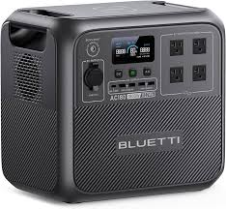
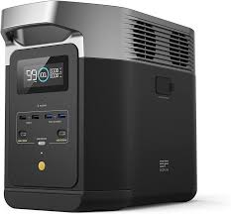
Recommended Minimum Sized Power Station for Cooking AND Refrigeration
With a 12 volt compressor fridge AND doing low Watt cooking you need to have a Portable Power Station with at minimum 1000 stored Watt Hours & a way to recharge it regularly, like solar panels
Make sure the Power Station you choose can output 12 volts WITHOUT shutting off due to low power draw – this is a critical for a 12 volt refrigerator, which cycle on and off
Bluetti AC180
1800 Watts AC Output
1152 Watt Hours Storage
500 Watts Solar Input
Cost about $700
EcoFlow Delta 2
1800 Watts AC Output
1024 Watt Hours Storage
500 Watts Solar Input
Cost about $700

Slide 13
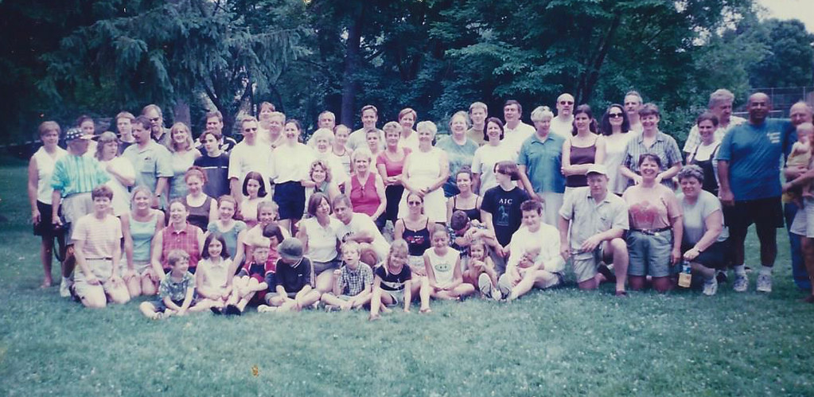
Can It Feed Everyone?
Here are some rough guidelines on what size of Power Station you need to power different Low Watt Appliances:
500 Watts AC Output: Only small rice cookers, mini griddles & immersion blenders. Good if cooking only for 1 or 2
800 to 1000 Watts AC Output: All of the above plus a 3 Quart Instant Pot or a 4 to 6 cup rice cooker. Good for about 2 to 4 people
1500+ Watts AC Output: All of the above plus a microwave, a 6/8 Quart Instant Pot and Vitamix style blender. Good for 5+ people
But don’t forget your Power Station can also act as supplement to your other, nonrenewable cooking resources, so a 500 Watt Power Station may still be helpful to feed a family of 6

Slide 14
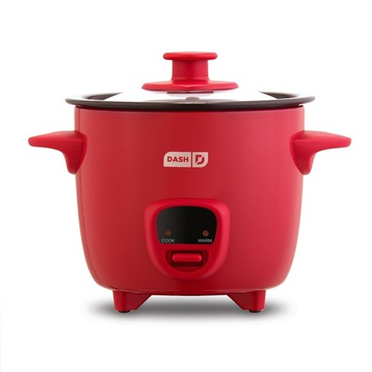
Great Low Watt Appliance (1)
Dash Mini Rice Cooker; 200 Watts; $22 - things you can cook:
2 Cups of cooked Rice or Quinoa: 35 minutes, 90 Watt Hours
3 small or 1 large Cinnamon Rolls: 30 Watt Hours
Heat a can of Chunky Soup: 40 Watt Hours
Boil 2 Cups of Water: 55 Watt Hours

Slide 15
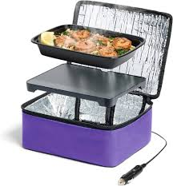
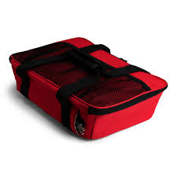
Great Low Watt Appliance (2)
HotLogic Mini or Max; 45 or 100 Watts; $40 or $80
Mini holds a 6 Cup, 8.75" W x 6.75" L x 2.5 H" glass, plastic, ceramic or paper containers of food, good for 1 or 2 people
Max (Family) holds a 3 Quart, 9" x 13" casserole dish
Cooks from raw but max temperature is 165 degrees F
A set & forget cooking device, no knobs or dials, doesn’t time out, holds food at a safe temperature for hours
Approx cook times for room temperature items: 1 hour; refrigerated items: 2 hours; frozen items: 3 hours. Multiply hours by 45 (Mini) or 100 (Max) to get Watt Hours
12 volt DC or 120 volt AC models available for the Mini
Does NOT boil water or brown food (much) but a super low wattage cooker/warmer. Think “slow cooker stuck on low”

Slide 16
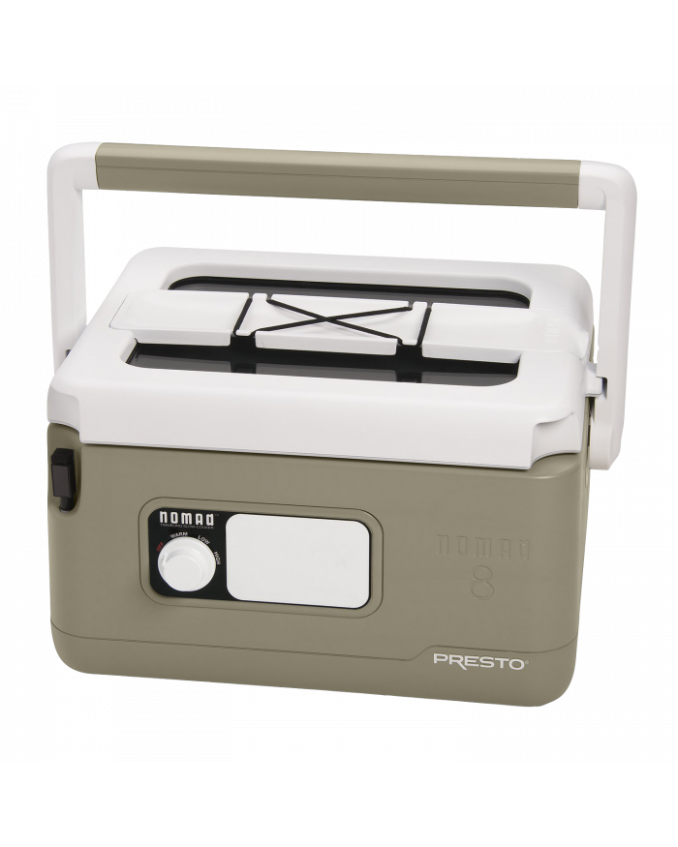
Great Low Watt Appliance (3)
Presto Nomad 6 Qt Slow Cooker
Cooks/Keeps Warm 6 Quarts of food
Power Usage:
Warm=35 Watts, Low=160 Watts, High=200 Watts
Designed to be portable & camp friendly:
Locking, gasket sealed lid
Rugged plastic exterior, carries like a cooler
Partially insulated already, a good candidate for thermal cooking
About half the weight of traditional crock pots at 8 pounds
A bit pricey at $85, watch for sales

Slide 17
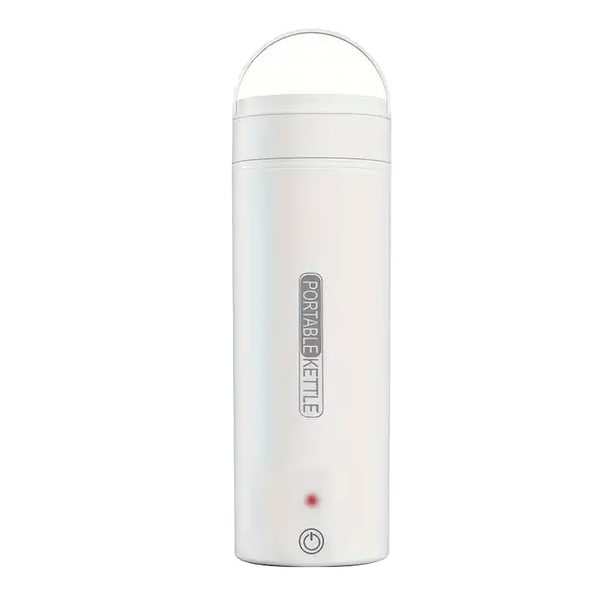
Great Low Watt Appliance (4)
Portable Travel Kettle; 300 Watts; $15 to $35
Many no-name brands available. Some feature selective temperature settings, spill proof lids and boil dry detection
Boils 350 ml (about 1 ½ cups) of water in 7 minutes, 30 Watt Hours
Perfect for:
French Press Coffee
Tea
Hot Chocolate
Dehydrated meals
Oats & other quick cook grains
Keeping warm with a hot water bottle
Cleaning/disinfecting

Slide 18
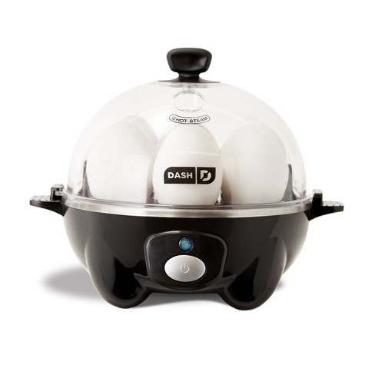
Great Low Watt Appliance (5)
Dash Mini Egg Cooker; 350 Watts; $20 - things you can cook:
7 Hard Boiled Eggs Using Only 2.5 Ounces of Water and 90 Watt Hours
1 Cup of Broccoli (steamed): 1.5 Oz of Water, 60 Watt Hours
4 Oz Fish Fillet: 2.5 Oz of Water, 90 Watt Hours
NOTE: A great way to steam small
quantities of food without using much water
(often in short supply in an emergency)

Slide 19
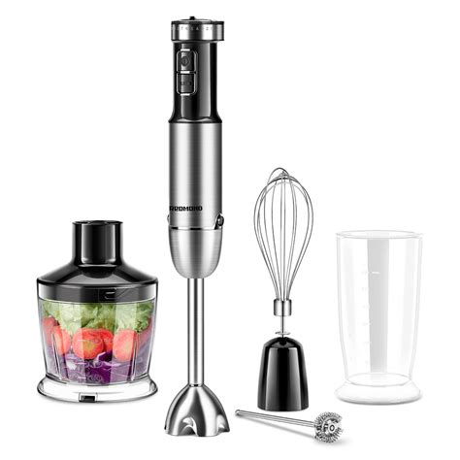
Great Low Watt Appliance (6)
An Immersion Blender; 200 to 500 Watts; $30 to $60 - things you can make:
Powdered milk butter (powdered milk & oil)
Nut butters
Cheese or cheese-less sauces
Batters, icings, even ice cream bases
Smooth out soups
Mayonnaise or Aioli
Pestos
Wisk & chop with attachments
NOTE: Immersion blenders love to claim hundreds of Watts in their advertising but usually use a fraction of that. They are also typically used briefly and so, consume few Watt Hours

Slide 20
Great Low Medium Watt Appliance (7)
3 Quart Instant Pot; 700 Watts; $80 - things you can make:
8 cups of soup: 350 Watt Hours, 4 Cups 170 Watt Hours
4 pints of yogurt: 120 Watt Hours on Yogurt function
Steam vegetables 5 minutes: 115 Watt Hours
4 Hour on slow cook mode: 300 Watt Hours
Thousands of recipes online & in cookbooks, a very versatile cooking tool
The inner pot with a lid can be used with thermal cooking techniques to cut power usage
NOTE: Instant Pots don’t always use their full
rated power. For slow & pressure cooking they cycle on
and off taking less watts than you would expect

Slide 21
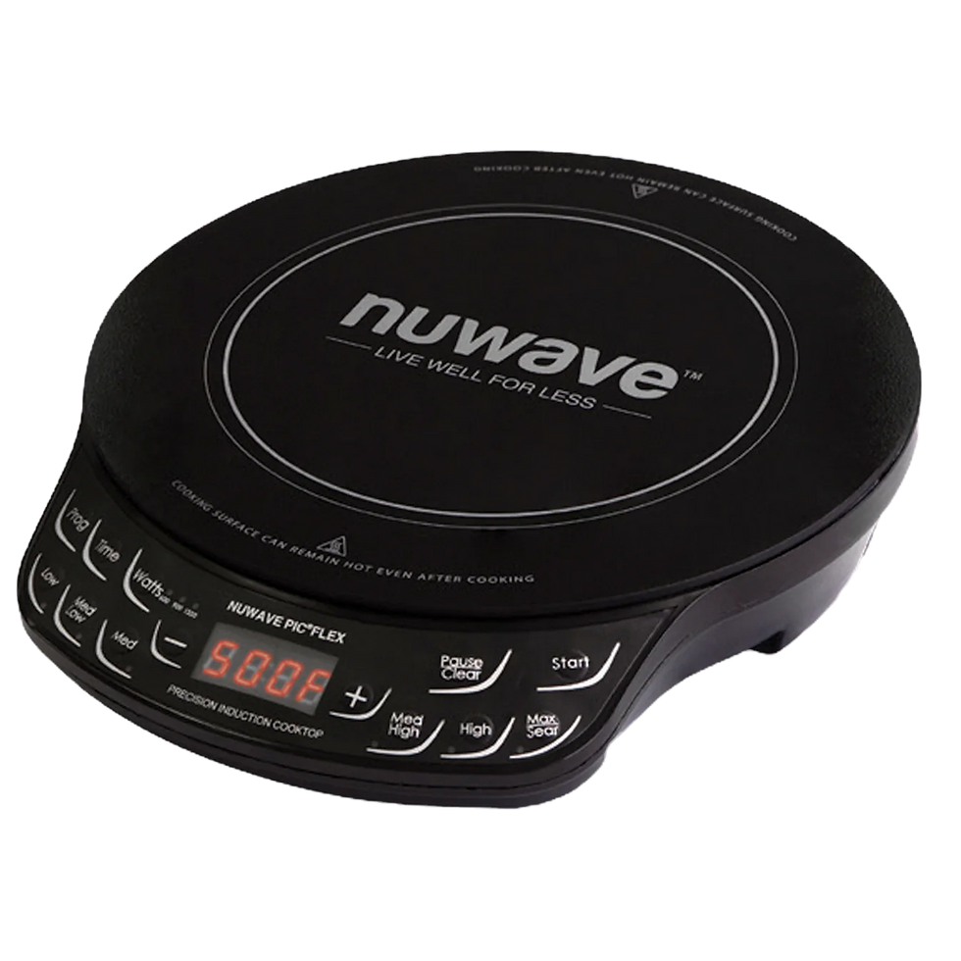
Great Low Medium? Watt Appliance (8)
Most Induction cooktops are high wattage (often 1500 Watts or more), however at lower temperatures/settings they use less Watts AC
Some models like this NuWave Gold 8 Inch actually allow you to select the maximum wattage used to 600, 900 or 1500 Watts. Using this feature or setting lower cooking temperatures allows you to use this high Watt appliance on smaller power stations
Like the other electric appliances mentioned here there is no exposed heating element which makes this appliance safe to use in a vehicle or tent
Induction cooking can be energy efficient since it directly heats the actual pot or pan with little energy loss

Slide 22
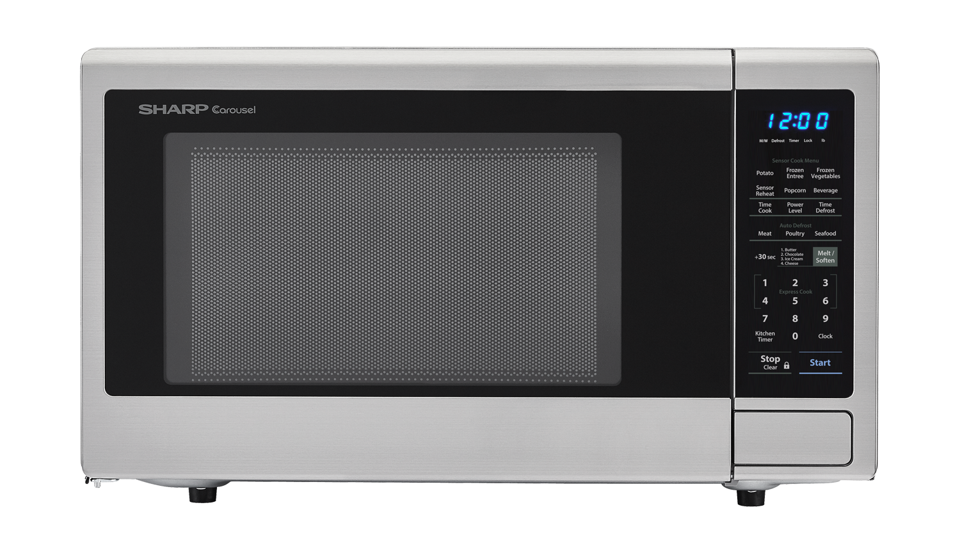
Microwave Myths!
Microwaves are advertised by their COOKING POWER, which is usually 30% to 35% LOWER than the actual Watts they draw
Most Microwaves vary their cooking power by cycling full power on and off. However, INVERTER microwaves actually run with lower watts on lower settings. This means that a power station that can’t output enough AC watts for high power may be able to still run an inverter microwave at a lower power level
Microwaves are not nearly as efficient as other forms of electric cooking. Fast, but not efficient

Slide 23
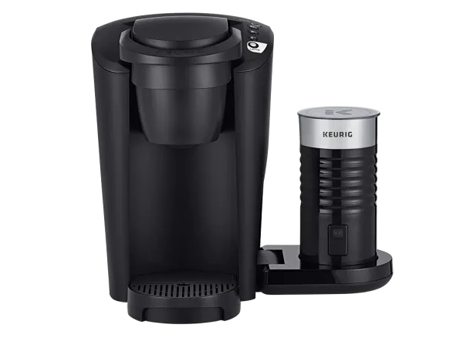
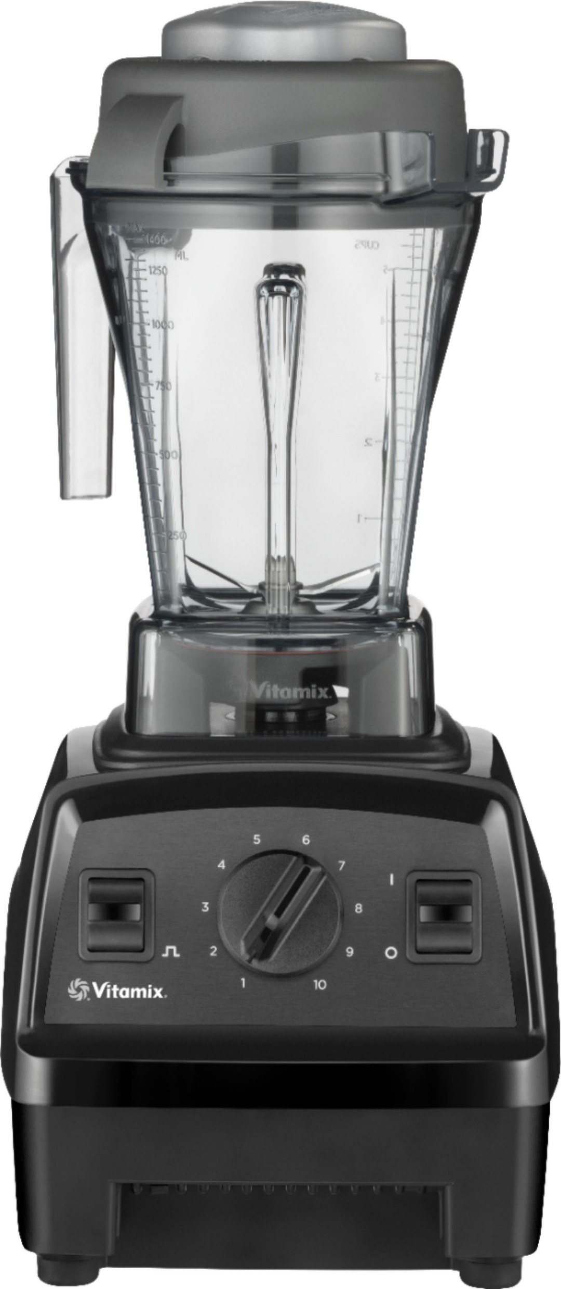
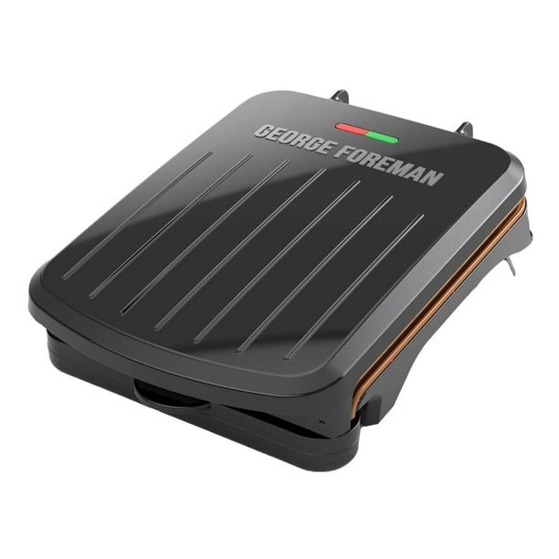
Higher Watt Appliances Examples
Keurig - Brew one 8 oz cup of coffee:
1300 Watts, 2 mins, 30 Watt Hours
Microwave:
1100+ Watts, Heat can of Chunky soup: 2 to 3 mins, 60 to 80 Watt Hours
Vitamix blender:
1400 Watts, Blend 16 oz smoothy: 2 minutes, 50 to 60 Watt Hours
George Foreman Grill
2 Person Model 760 Watts, Grill 2 burgers: 7 minutes, 90 Watt Hours
4 Person Model 1800 Watts, Grill 4 burgers: 7 minutes, 210 Watt Hours

Slide 24
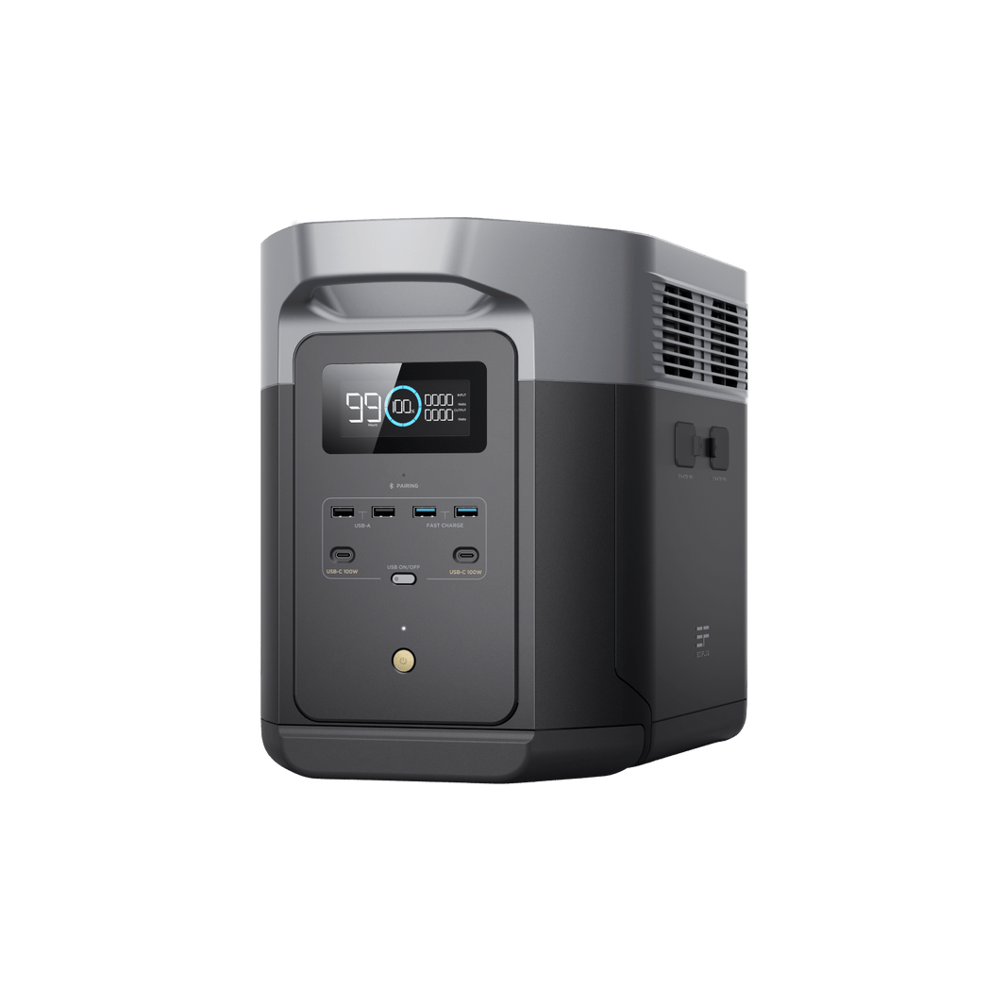
Portable Power Station Purchasing Tips
Buy a known brand, especially if this is your only Power Station. You want a well made unit with a warranty that actually means something
Only Buy LFP! (LifePO4 or Lithium Iron Phosphate) batteries vs regular Lithium Ion. LFP, while slightly heavier, lasts 4x to 6x longer and do NOT suffer from thermal runaway fires, making them dramatically safer
Current top brands:
Ecoflow (slightly more expensive, OK customer service)
Anker (mid price & OK customer service, but not as popular)
Jackery (higher price, OK customer service) WARNING: ONLY their Plus models (300 Plus and 1000 Plus) have LFP batteries
Bluetti (inexpensive, good products but poor customer service)
Notable Budget Brand: OUPES, surprisingly OK service & quality on their smaller units, excellent Facebook group, very inexpensive (< 50 cents / Wh)
Goal Zero - High cost & generally behind in features

Slide 25
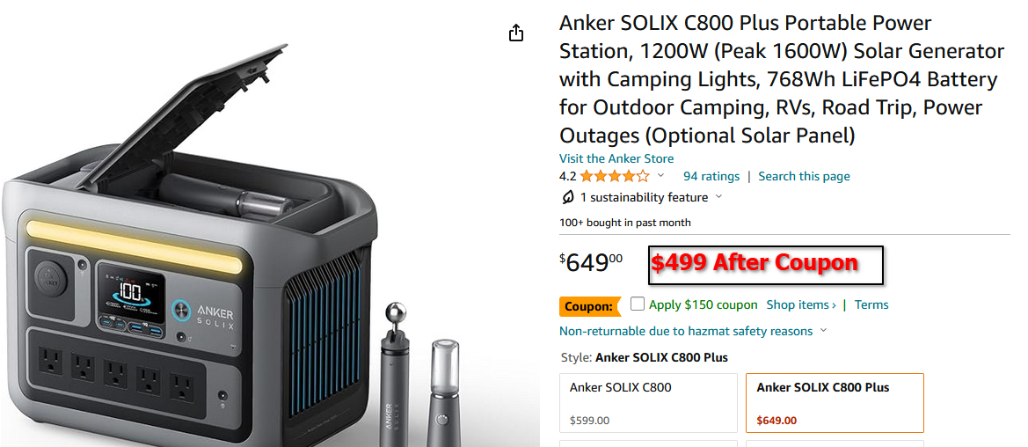
Portable Power Station Purchasing Tips 2
As of 2024, the LIST price for mid sized Power Stations (500 to 1200 Stored Watt Hours) is $1.00 - 80 cents per Watt Hour BUT there are FREQUENT discounts. Shop for a price between 65 to 55 cents per Stored Watt Hour. Below 55 cents is a real steal for a name brand
Example: The Anker Solix C800 Plus shown below costs $499 (after coupon) so it is: $499 / 768 Wh (Stored Watt Hours) = about 65 cents per Watt Hour
All the major brands have sales regularly, NEVER PAY LIST PRICE!

Slide 26
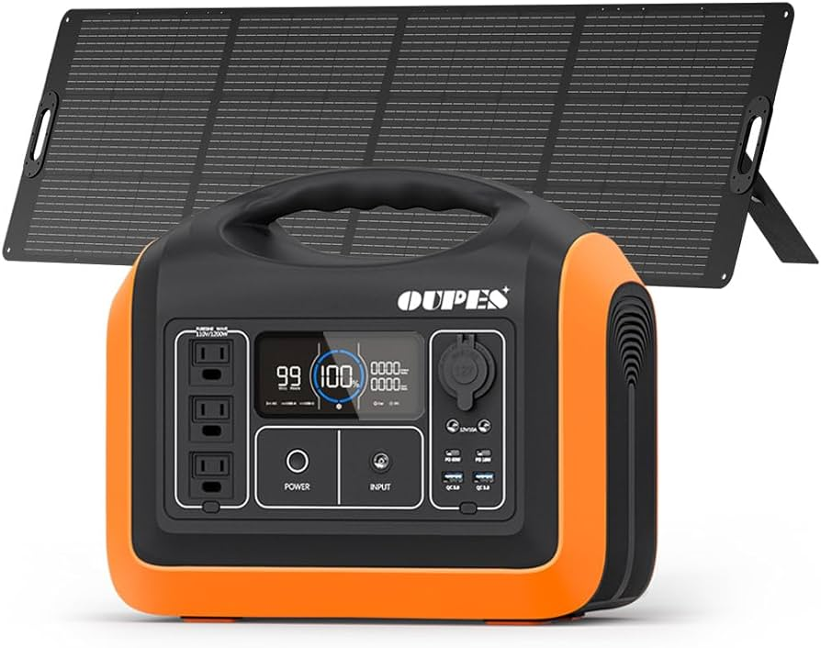
Portable Power Station Purchasing Tips 3
Right size the Power Station & solar panels for your needs – remember the 3 Types of Watts: AC Output Watts, Stored Watt Hours & Solar Input Watts!
Target having enough solar to charge the station in 5 hours or less
The Power Station’s Solar Input Voltage range must cover the Open Circuit Voltage of the solar panel(s)
Compare the AC and DC output efficiency of the Portable Power Station. It can range from 70% (poor) to 85% (average) to 90% (excellent). More efficient output means you are getting more Stored Watt Hours for your dollars!

Slide 27
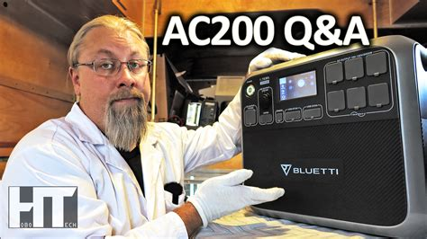
Portable Power Station Purchasing Tips 4
Watch reviews on the Power Station make/model before you buy. Watch technical reviewers (which makes it harder to miss/hide flaws) like these YouTubers:
HoboTech, Jasonoid, ReeWray Outdoors Watch out for casual or overly glowing, sponsored reviews/ads for subpar systems (*cough*4Patriots*cough*)
Never buy a Power Station that doesn’t have “Pass Through Charging”, which means it can power things while it is being charged
Wholesale clubs like Costco have good return policies & carry Ecoflow & Jackery, sometimes at good prices

Slide 28
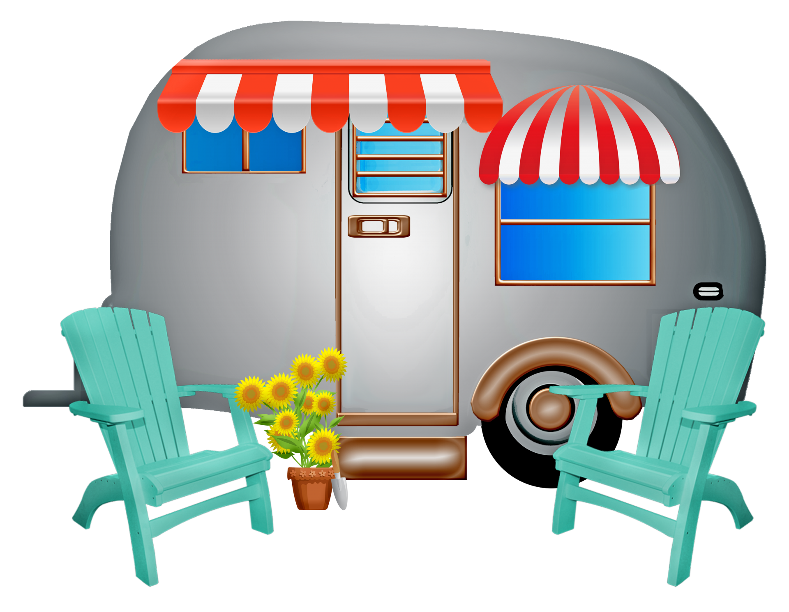
Low Watt Cooking Can Be Useful Every Day
Load up your HotLogic with left overs or a frozen meal and plug it in at work vs eating out. Within a year you will have easily saved enough for a Power Station, solar panel and every appliance mentioned here
Turn Camping into Glamping with lights, music & hot meals with your Portable Power Station & an Instant Pot. Especially with open fire bans in many campgrounds you may have limited ways of cooking anyway
Save money at hotels or dorms. Room service is expensive but having a small rice cooker means you can cook meals in your hotel/dorm even if they don’t provide/allow a microwave
Car, Van or RV living. With a folding solar panel, a Portable Power Station and some low watt appliances you can literally live & cook out of your vehicle indefinitely - #vanlife

Slide 29
Finally, My #1 Takeaway: Practice
Don’t wait until an actual disaster to practice your preparedness!
A LFP Power Station should still hold 80% of it’s rated Watt Hours after 3000 full cycles. That is over 8 years of daily cycling, so feel free to use it!
Strut your low watt stuff – fix cinnamon rolls in a Dash Mini rice cooker, Instant Pot cheesecake or HotLogic Italian chicken (all amazing, btw)
Make it a fun challenge! Take your Power Station & Low Watt Appliances to the park and fix lunch. Not only will you learn to use your new, amazing tools but you might also realize that your only cutting board weighs 20 pounds, your pocket knife is way too small for kitchen work and you forgot to bring things like salt & a can opener (or some other valuable ‘oops’ lessons)
Finally, test your Power Station with every appliance/solar panel you plan on using it with. Likely everything will work fine but, if not, you want to know before a emergency

