Slide 1
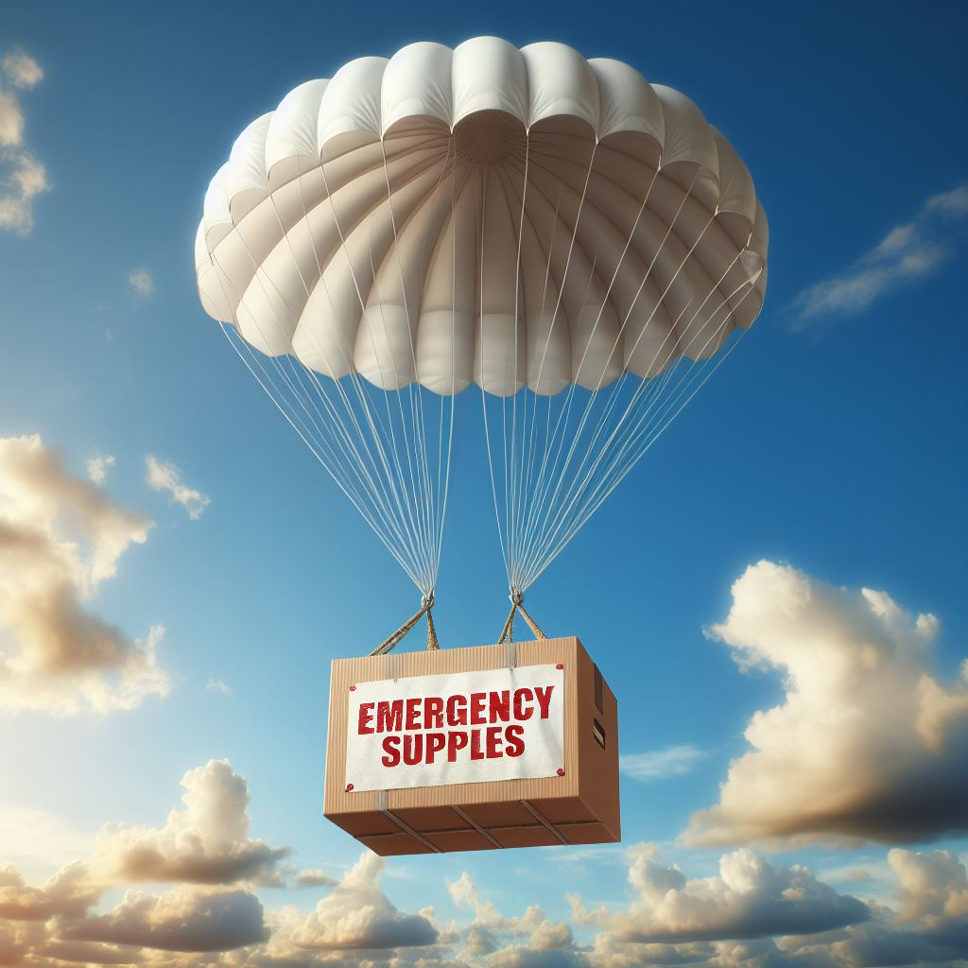
Recipe for a Two-Week Survival Plan
From the Plano, Texas Stake

Slide 2
How Do We Prepare for Emergencies?
Our Stake leaders encourage us to:
Identify and plan for the disasters most likely to occur in our area
Store water for an emergency
Store food and medications for an emergency
Plan for sanitation needs during an emergency
Have an evacuation plan in the event you need to leave
Have emergency financial reserves
Have a plan for communicating in an emergency

Slide 3
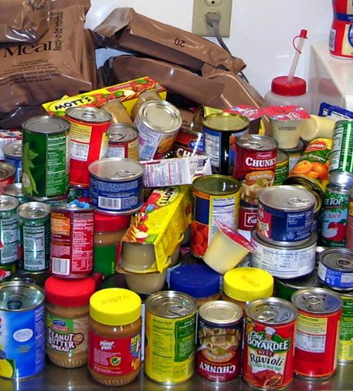
“Members are to have supplies on hand to support themselves independently for at least three days, and strongly recommended for two weeks during an emergency event. “
Plano Texas Stake Presidency

Slide 4
Involve Your Family
Use input from family members to help formulate your Two-Week Survival Plan!

Slide 5
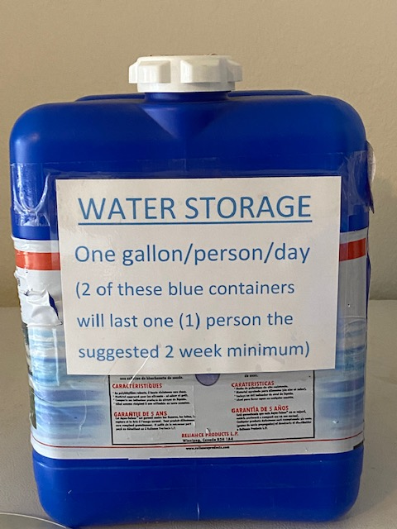
Store Water for an Emergency
Minimum1 gallon/person/day (more if infants and small children or special health needs)
FEMA and the American Red Cross are now saying 2 weeks (instead of 72 hours) for taking care of yourself – food and water
Store water beyond your basic drinking needs if you are able

Slide 6
How to Store Water
Use ONLY food grade containers with a PETE or PET recycling symbol on them:
Don’t re-use milk or water jugs. Most do not have adequate lids
Don’t use containers that have been used to store chemicals or non-food (beverage) items even if they are marked PETE or PET
Store in a variety of sized containers (some for easy transport if evacuating)
Dark-colored opaque containers work best to prevent the growth of algae
Water from a chlorinated municipal water supply does not need further treatment

Slide 7
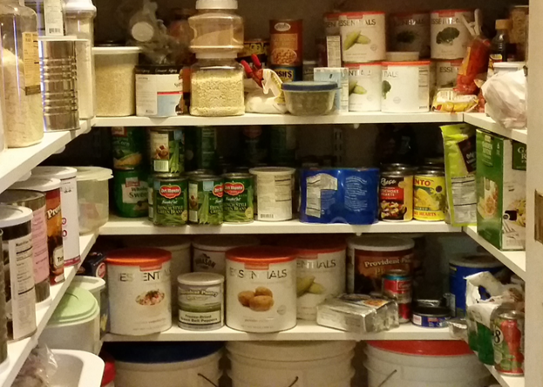
Emergency Food Supply
Ensure you have at least a two-week supply of food
Store shelf-stable foods that need no refrigeration and minimal preparation
Store foods your family will eat
Consider using a one-week menu, repeated twice

Slide 8
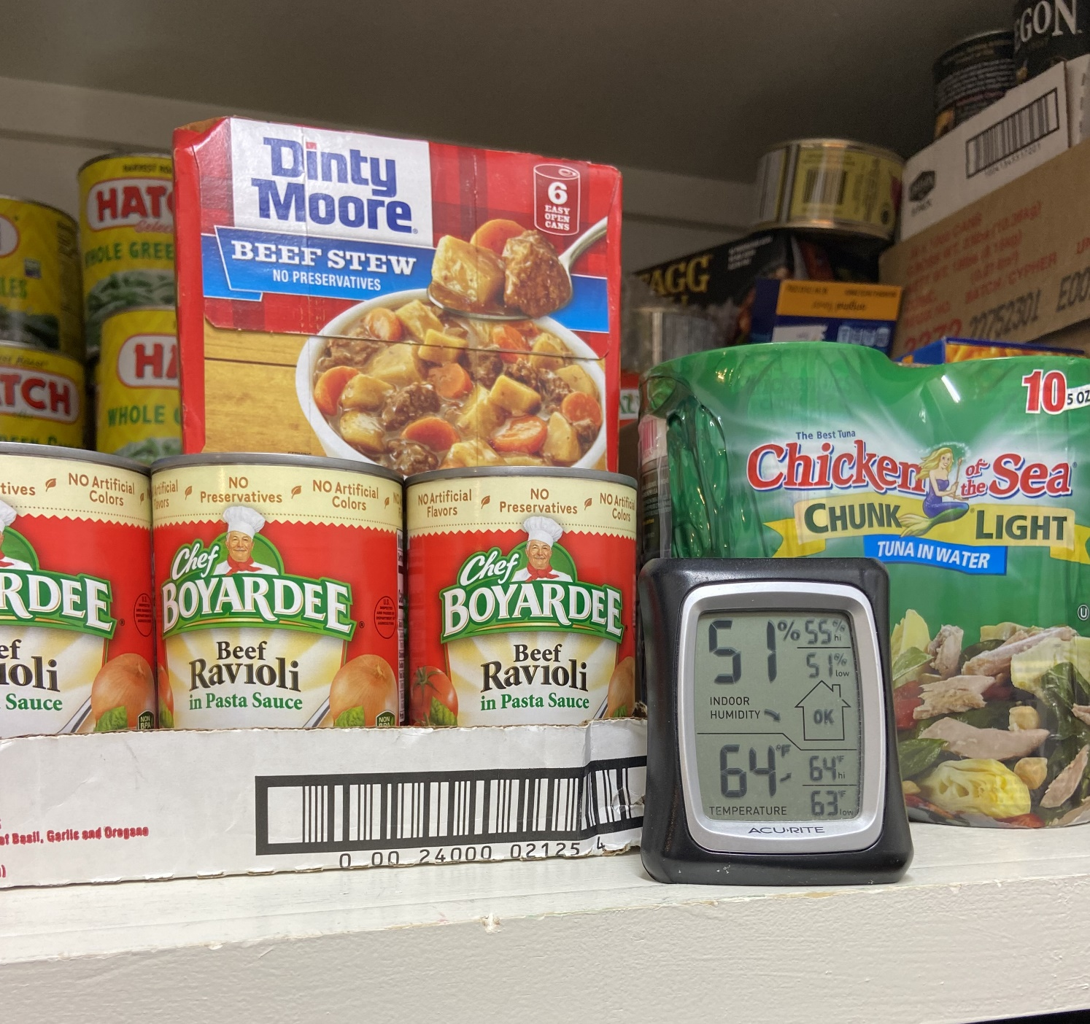
Store Your Food Properly
(Best conditions: Cool, dry, and dark)
It is recommended that you keep most foods at 74° or less. (If this is not possible, do the best you can.)
Keep moisture as low as possible
Keep clear containers away from light
Keep free from pests
Follow safety guidelines for home produced foods

Slide 9
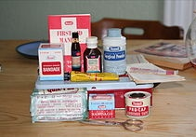
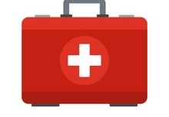
Store Medications and First Aid Supplies
Teach family members first aid basics

Slide 10
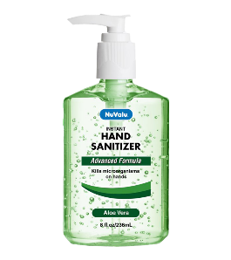
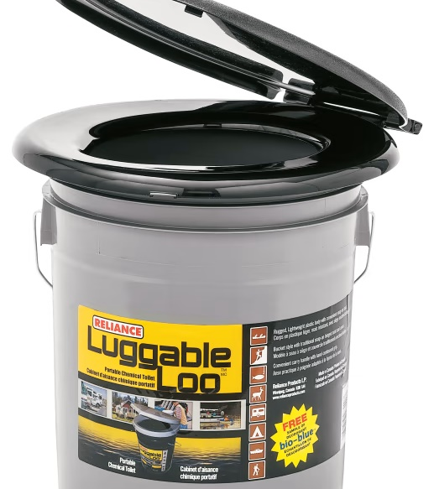
Sanitation and Hygiene
Have a plan for handling bodily wastes
Follow instructions on chemical treatment methods
Have hand sanitizers available
Keep cleaning supplies on hand
Keep food preparation areas sanitized

Slide 11
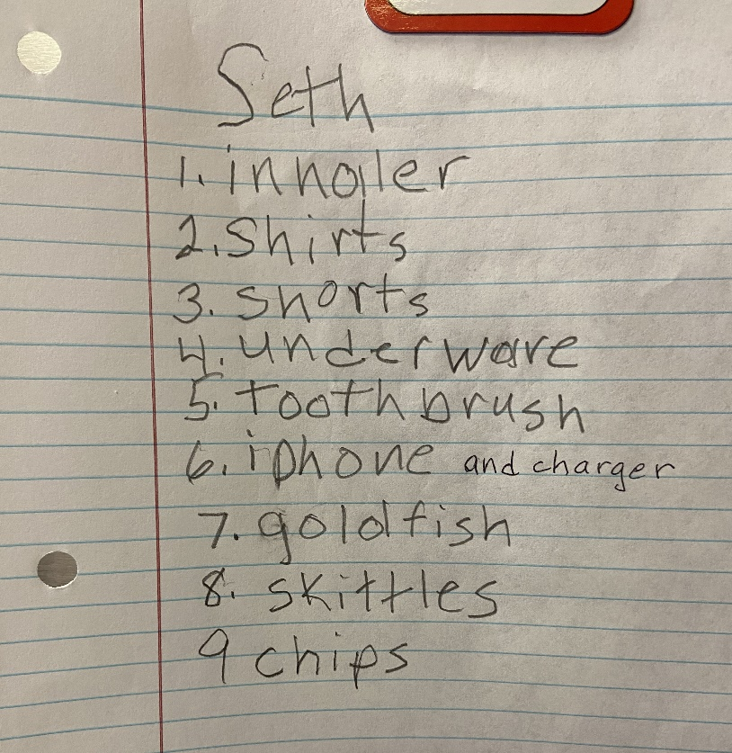
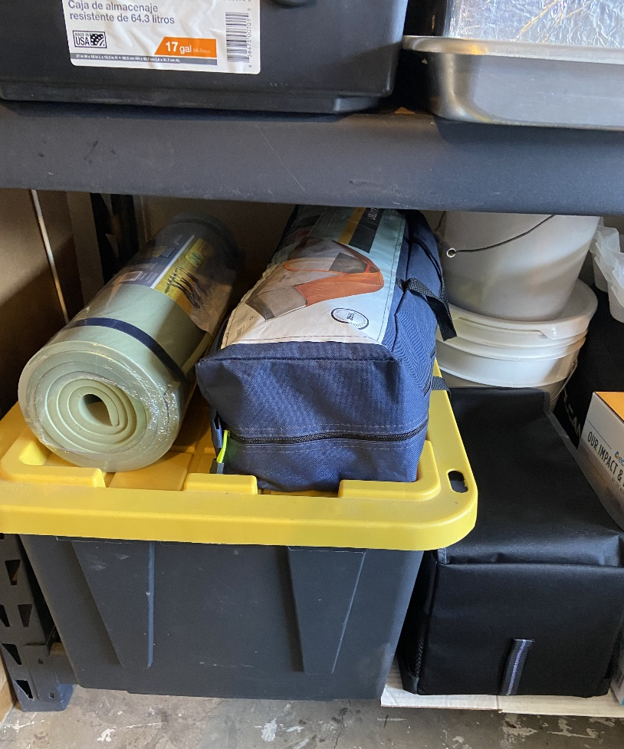
Have an Emergency Evacuation Plan
Have each member of your household make a list of things they would take if they had 30 minutes to pack up to evacuate.
Keep the list on the refrigerator or in a prominent place
Consider having a “Grab and Go” container or containers ready in case evacuation becomes necessary
Choose a container or containers that are portable. Gather what you have, and slowly add to it

Slide 12
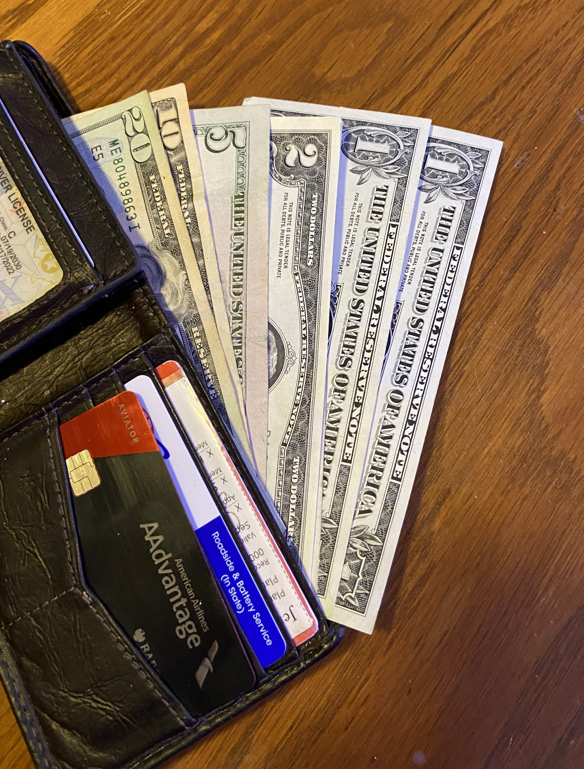
Anticipate Money Needs
Store cash, sufficient for two weeks, in small bills to make it easier to pay for things if electronic processing is not available

Slide 13
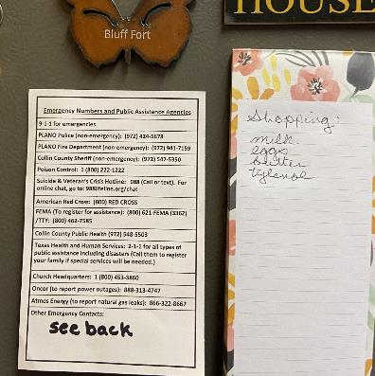
Emergency Communications
Have a plan on how you will contact family members and friends in the event of an emergency
Know your Ward Communications Specialist(s)
Keep emergency numbers posted in a prominent place for easy access
Have a hard copy list of emergency contact numbers. Include relatives and friends. This may come in handy if cell phone service is down and you must rely on the services of Ham radio operators to reach people
Note that if cell phone service is down during an emergency, texting may still work

Slide 14
And Finally ...
In his October 1995 Conference address, Elder L. Tom Perry said: “The need for preparation is abundantly clear. The great blessing of being prepared gives us freedom from fear, as guaranteed to us by the Lord in the Doctrine and Covenants:
“If ye are prepared ye shall not fear” (D&C 38:30)

Slide 15
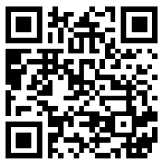
To access the Two-Week Survival Plan on the Plano, Texas Stake Emergency Preparedness website, use this QR code or see the link below.
https://www.preparednessplano.org/?page_id=1490

