Slide 1
Water, Water Everywhere or is there?
Duana Blakey
September 21, 2013

Slide 2
Why is water so important to us?
Our body is 60 to 70 % water or about 14 gallons
Lose 3 quarts a day normally, more in excessive heat or exertions
Need to replace at least 1 gallon per day
Cooking, cleaning, laundry, flushing toilets, pets, gardens, first aid, personal hygiene and more
Cert Training- if thirsty you are already in trouble
Don’t ration water; better to store in your stomach
We can survive 3 minute without air; 3 hours without shelter; 3 days without water; 3 weeks without food
So how much does the average person use per day?

Slide 3
My water bill usage
Month | Total usage | Per day
July 2012 | 4000 | 133.33
August | 3500 | 116.67
September | 5200 | 173.33
October | 7800 | 260
November | 1500 | 50
December | 1500 | 50
January 2013 | 1500 | 50
February | 2000 | 66.67
March | 1500 | 50
April | 1500 | 50
May | 1000 | 33.33
June | 2000 | 66.67

Slide 4
Why Store Water?
We have been told to by our Prophets for years
Natural disasters - tornados, floods, ice storms & more
Water pipeline break that takes time to repair
Water treatment plant fails
No electricity for the pump stations
Contamination – US averages 1 “boil water” warning a week
Civil unrest
Dam breaks accidental or terrorism – Lewisville dam needs repairs now 100-200 million dollars worth

Slide 5
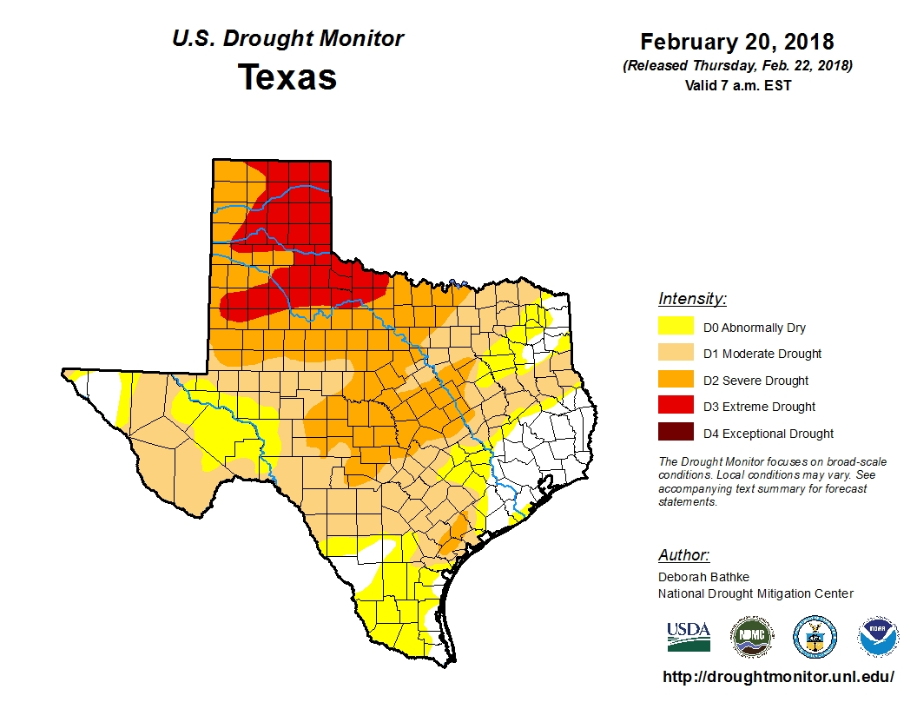
Drought - http://droughtmonitor.unl.edu/

Slide 6
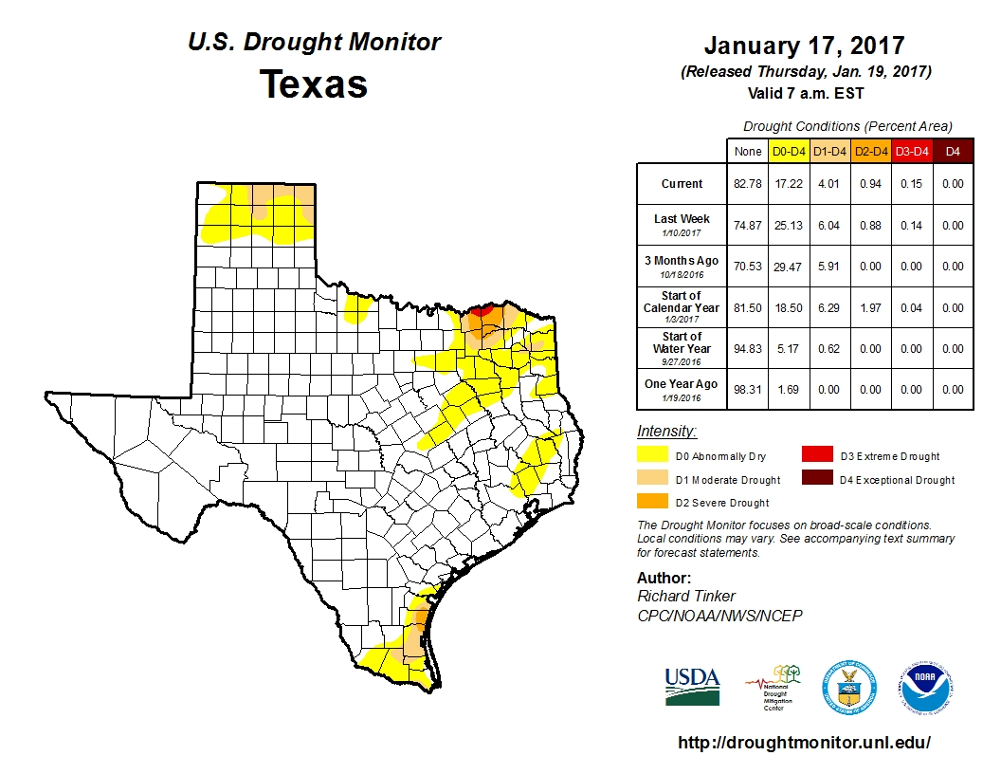

Slide 7
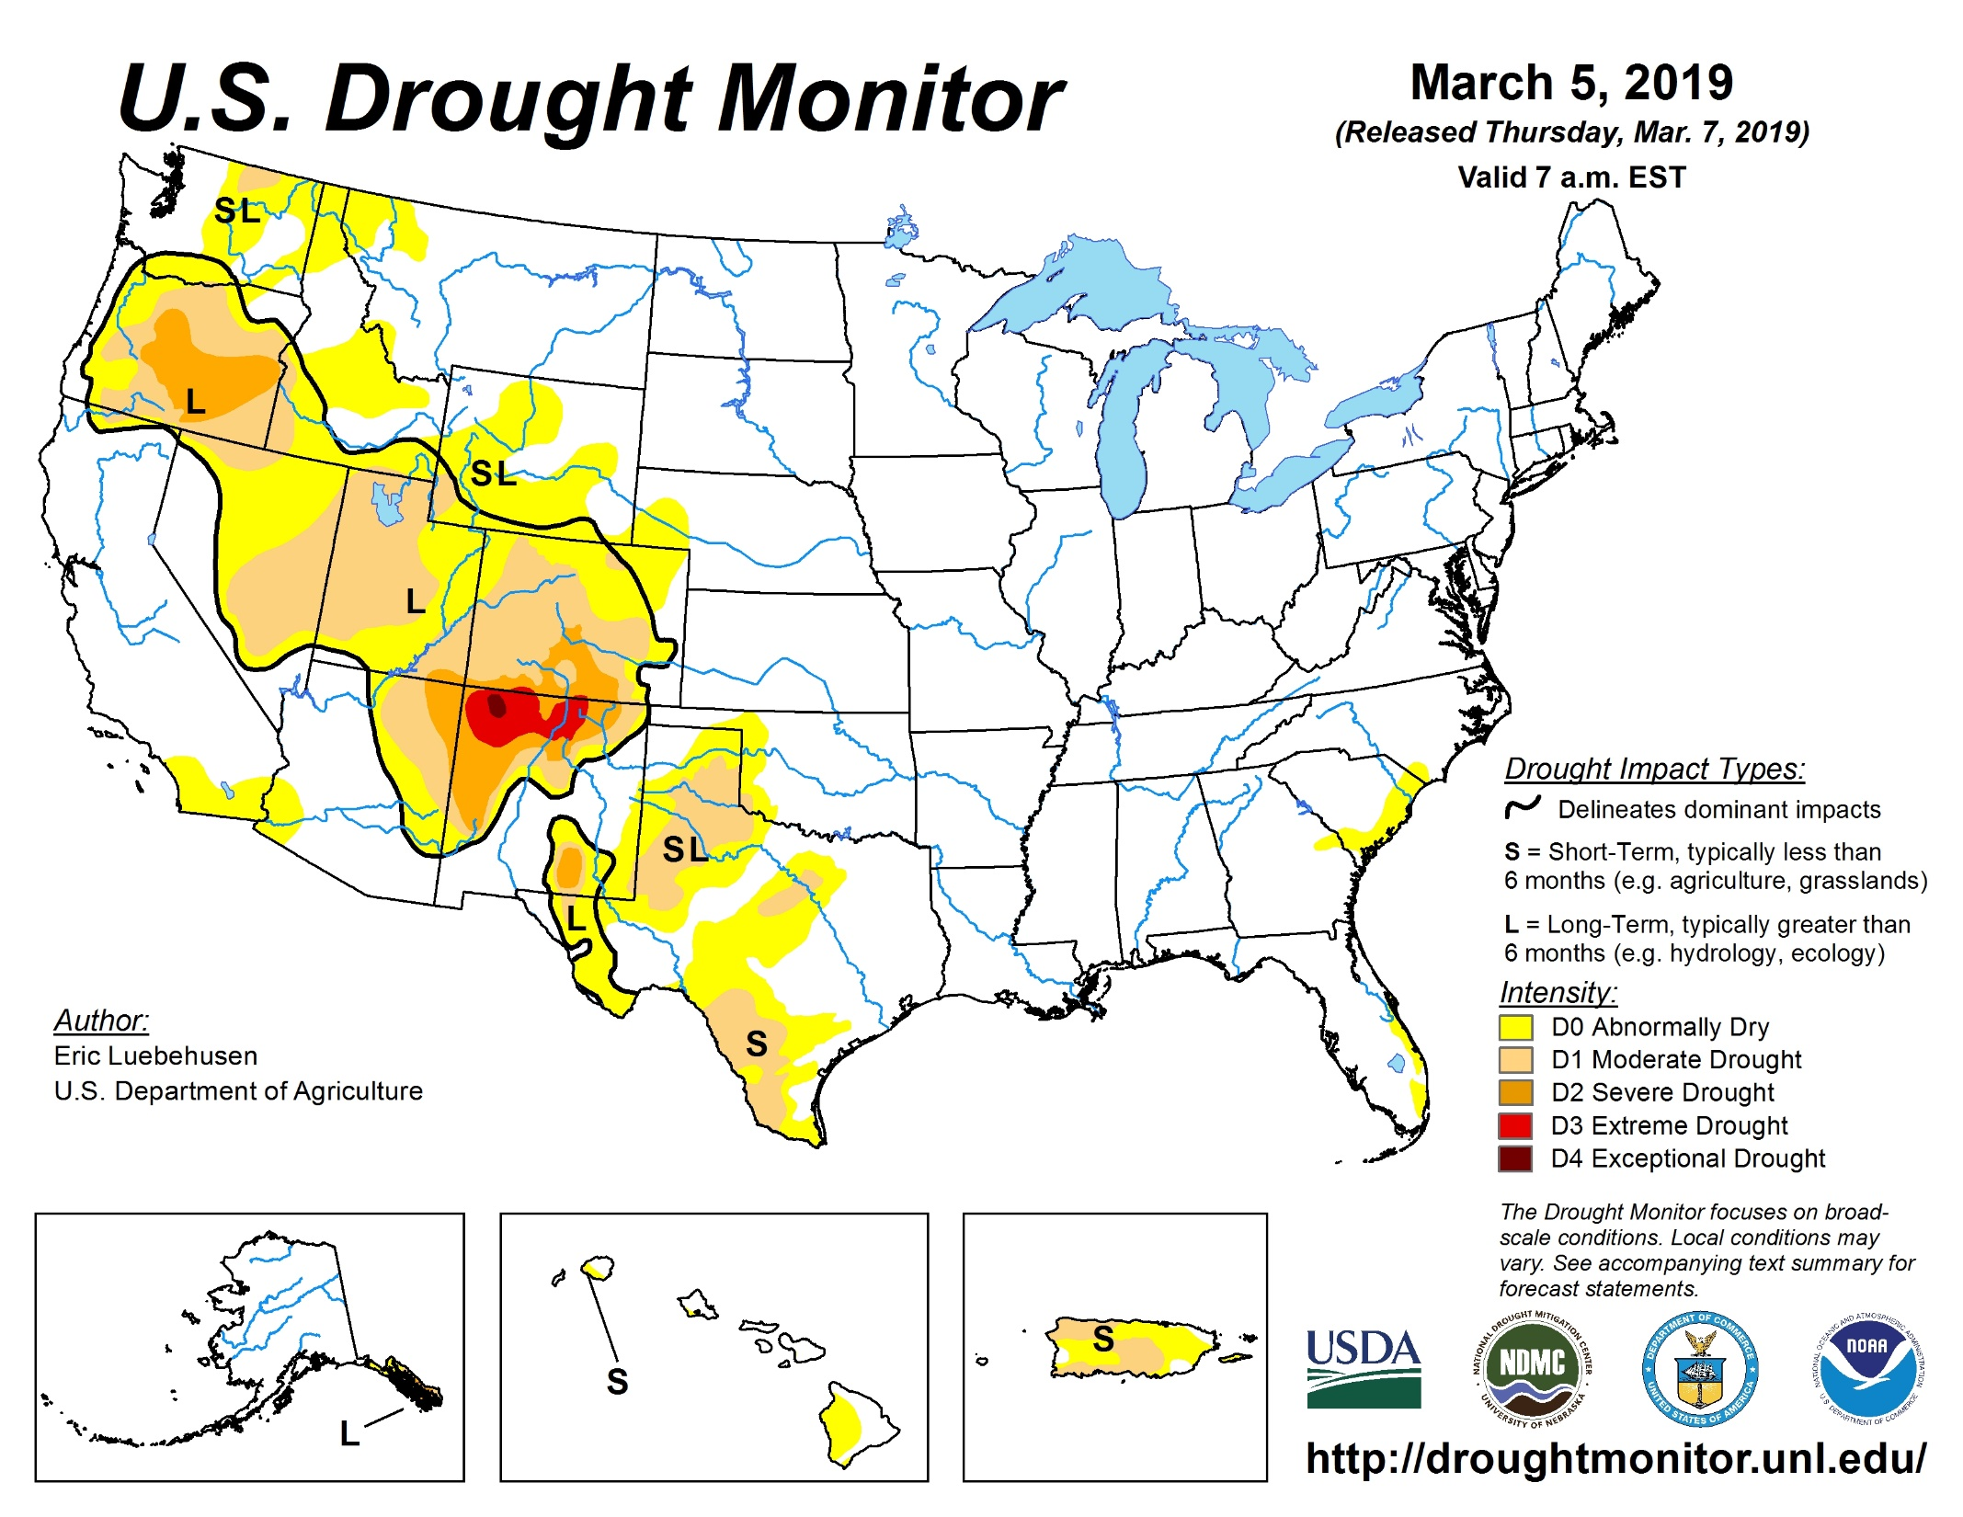

Slide 8
Texas Co-op magazine
August 2012
Last big drought in Texas was 1940-1950’s
Texas water laws:
Surface water –lakes, rivers, creeks are considered a public resource commonly owned by the people of Texas
Groundwater – Under the surface is regarded as a mineral right and you can drill and take as much as you want.
Ozarka does this here in Texas.

Slide 9
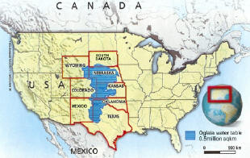
Ogallala Aquifer

Slide 10
Aquifers like the Ogallala are being depleted faster than they can be refilled
Droughts in the Midwest farming country cause them to use it more for irrigation than normal.
The Texas population is expected to double in the next 50 years and we have already given permission for more water to be withdrawn from our rivers and lakes than is actually in them.
There is some discussion about changing these laws so if you are interested in a rainwater catch system you should do it now.
Both China and Russia went thru severe drought in 2010
Some people think water may become so scarce it will start wars. Not hard to believe since without it we die.

Slide 11
How much should I store?
LDS church did say 1 gallon per person per day for 14 days. Now no specific amounts are given.
FEMA is saying 2 weeks of food and water now instead of 72 hours
Do you drink bottled water? How much a week?
Some people will not drink water – get them use to it
Kool-aid and other things can help but your kidneys see this as waste and work harder to get rid of it.
Do you garden? Rainwater system can help that

Slide 12
How to use less water
Some things will get cut down – showers, laundry
If it’s yellow let it mellow; if it’s brown flush it down
Sponge baths take less water
Bug sprayer shower from www.disasterguy.com be sure to mark this and never use it for anything else. 2 gallons of water will do it. Spray – lather - rinse
Set up toilet in 5 gallon bucket with special doody bags or double up garbage bags. Enzymes can be bought at Wal-Mart RV section or at any camping or EP store
If you think about it you can come up with lots of ways to use less water
Have paper products for eating on hand to use less H2O

Slide 13


How and what to store
Use ONLY food grade containers – if food came in it it’s safe
PETE or PET, HDPE should be on it somewhere
A link to containers and packaging Gives info on each plastic abbreviation
5 Gallon buckets from Walmart, Lowes, Home Depot are safe.

Slide 14
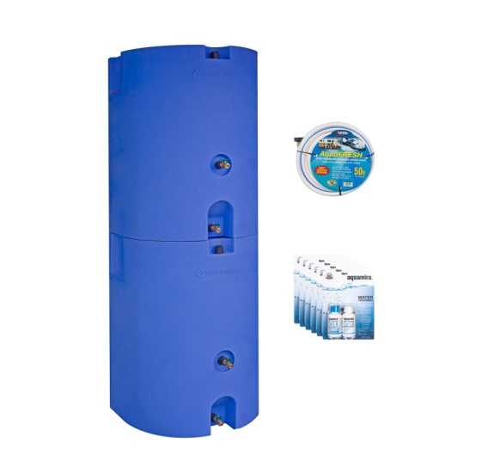
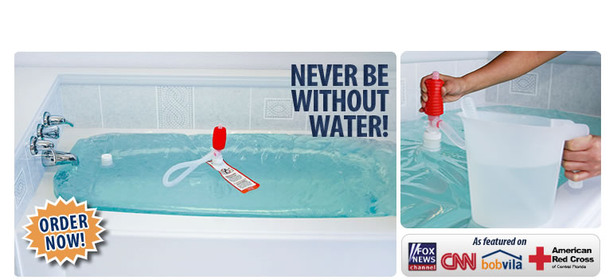
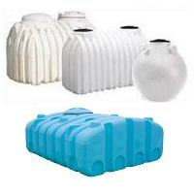
Don’t use milk jugs – they will leak eventually and don’t buy water in them for long term storage.
Some examples – 5 gallons, 7 gallons, 55 gallons, 320 gallons and larger; bottled water, juice bottles, soda bottles, boxes and Mylar bags, water bob

Slide 15
Don’t store lots of these big ones on one side of your garage – you will crack your foundation.
Water from a Chlorinated municipal water supply does not need further treatment when stored. Lds.org
Non- chlorinated water should be treated with bleach. 8 drops per gallon. No scents or additives
Bleach has a 6-9 month shelf life. Higher temp shorter time. Powder bleach last longer.
Light encourages the growth of living things so dark is better for storing
Too much heat or cold is not good for it
Containers should be emptied and refilled regularly

Slide 16
I have read everything from 6 months to 5 years on this.
Store where a possible leak will not cause damage to your home.
The flat taste of stored water can be improved by pouring it back and forth between containers. It’s not bad just lost its Oxygen. This helps put it back
So in non emergency situation you can get water from your tap or from bottled water in the store.

Slide 17
Rainwater Collection
Texas offers a sales tax exemption on the purchase of rainwater harvesting equipment. Both Texas and Ohio allow the practice even for potable purposes.
Most Western states make it illegal to collect rainwater but California just made it legal again.
Due to leaching of toxins, composite or asphalt shingles are not appropriate for potable systems, but can be used to collect water for irrigation, flush toilets, etc.
A 2,000 square foot roof could produce 1,200 gallons of water that could potentially be collected.

Slide 18
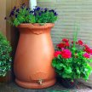
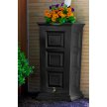
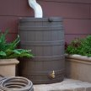
Some rain barrel systems

Slide 19
Homemade systems
Going to youtube.com and putting in 55 gallon blue barrels will give you tons and tons of ways to use these barrels. Everybody has a way to make rain barrels out of them.
You can buy these new from $75 to $150 each
I have access to used ones for $15 each. They come from restaurants and had things like vinegar, soy sauce, etc in them. If you are interested in these I have a sign up sheet on the table. I usually have barrels available but you must come to Little Elm to pick them up.

Slide 20
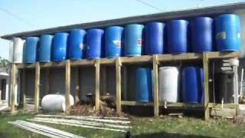
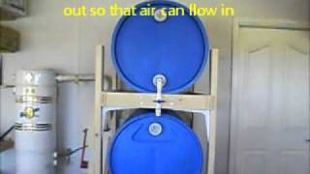
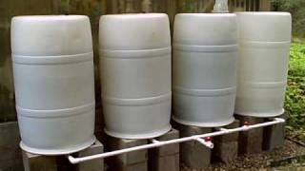

Homemade Examples

Slide 21
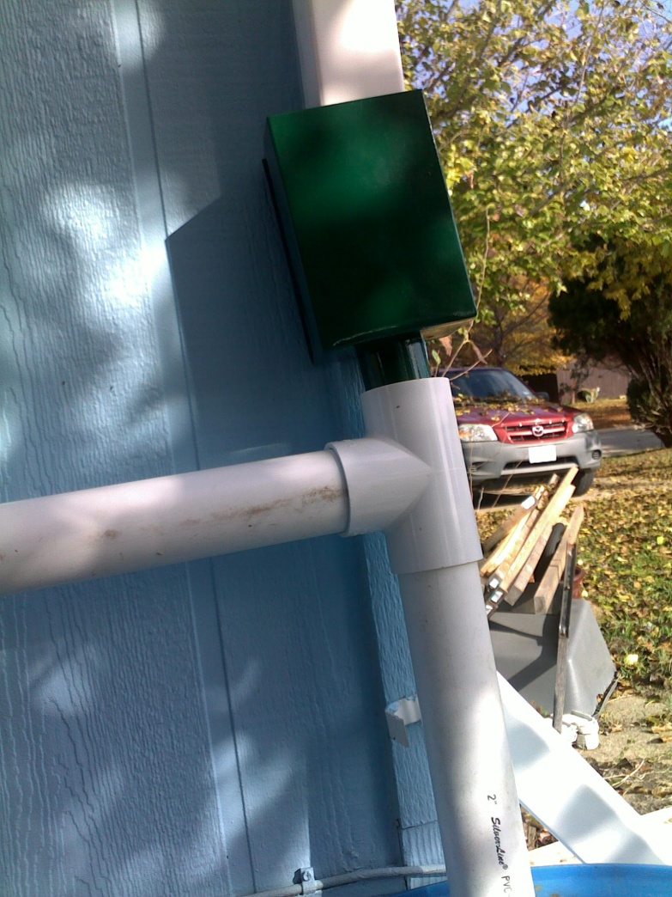
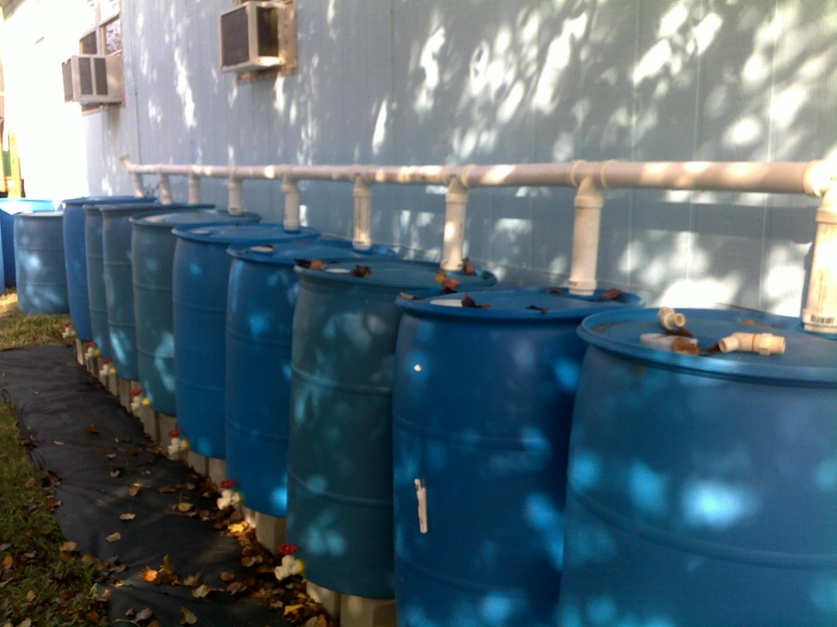
My Personal Rain barrel system

Slide 22
Where to get water when the tap is dry
Hot water heaters
Swimming pools
Hot tubs
Fountains
Ponds and lakes
Rivers, streams, creeks
Condensations – solar stills, Dew, etc
Lowland catches – dig a hole and wait for it to fill
Snow or ice storms
Some plants – Prickly pear cactus, thistles, walnut, maple or hickory trees can be tapped
Commercial Buildings using a sillcock key

Slide 23
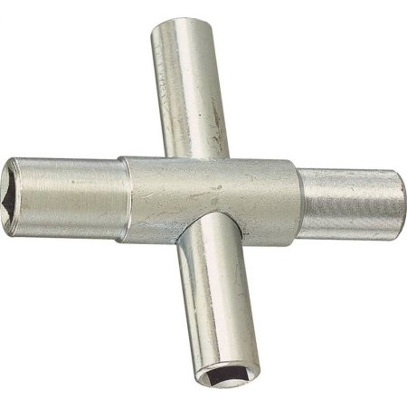
Sillcock Key

Slide 24
What to worry about from these sources
Pesticides, herbicides, engine oil
fecal matter, cleaning solutions, chemicals
bacteria, virus, insect eggs or larvae, worms
Dirt, plant material, heavy metals, other toxic runoff
Most of these can be eliminated with filtering or boiling
How big is an organism and so how small must the filter be?

Slide 25
Organism - Average sizes
Viruses ---------------------- 0.03 microns
Enteric bacteria (E. coli) ----- 0.5 × 3.0–8.0 microns
Cryptosporidium oocyst------ 4–6 microns
Giardia cyst ----------------- 6.0–10.0 × 8.0–15.0 microns
By the CDC guidelines, .02 microns should remove just about all viruses.
If you are buying filters be sure they will filter that small

Slide 26
Water Purification
Water purification is a process in which all types of impurities, contaminants and pollutants are removed from the water.
Most purification processes involve multiple steps, especially when water purifying is done in emergency conditions.
Contaminated water can cause severe problems including
Severe and prolonged diarrhea
Diseases like cholera and typhoid
Parasites in your digestive system
Leeches
Infections

Slide 27
Remember that water in a mountain stream can be just as contaminated as city sources. There are critters up there that don’t care where they do their business!
You may have to use more than one method to purify your water.
But all methods would require you to filter out the larger impurities before proceeding.
You may also want to let the water sit so that any dirt or particles that did not filter out will settle to the bottom.
1000 coffee filters at Sams for $6. These are great filters for smaller amounts
You should always purify any water that does not come from a water treatment plant.
You will get all kinds of different opinions on what to do and not to do. Common sense and experience will get you through most of the time.
When in doubt purify, you can’t afford to get sick.

Slide 28
Filtration
Can use cheesecloth, coffee filters or other material to filter out large stuff.
You can buy a filter system. Show Just water filter system. Ceramic. Gravity fed.
Water bottle and water straws
You can also make your own if you want. Lots of sources on the internet to show you how but basically a 2 bucket system where the top bucket has layers of gravel, sand and charcoal to filter out the impurities.
Most of these will last about 6 months before needing to be replaced.

Slide 29
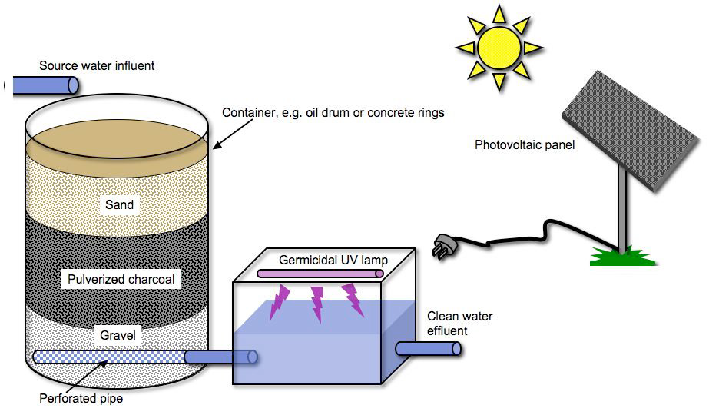
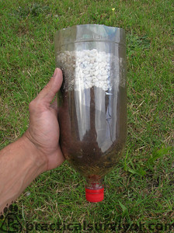
Homemade filtration system

Slide 30
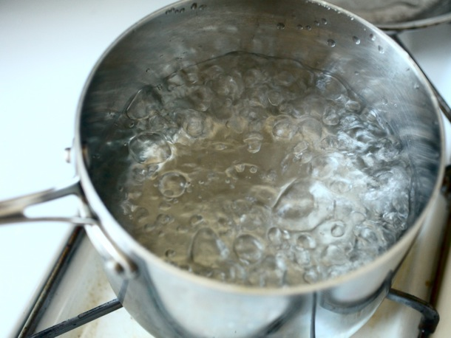
Boiling
You can boil water to kill everything in it. Just boil for 3 minutes. The longer you boil the more water you lose.
This will not remove toxins, chemicals, heavy metal, etc
Boiling does not kill Protozoan!

Slide 31
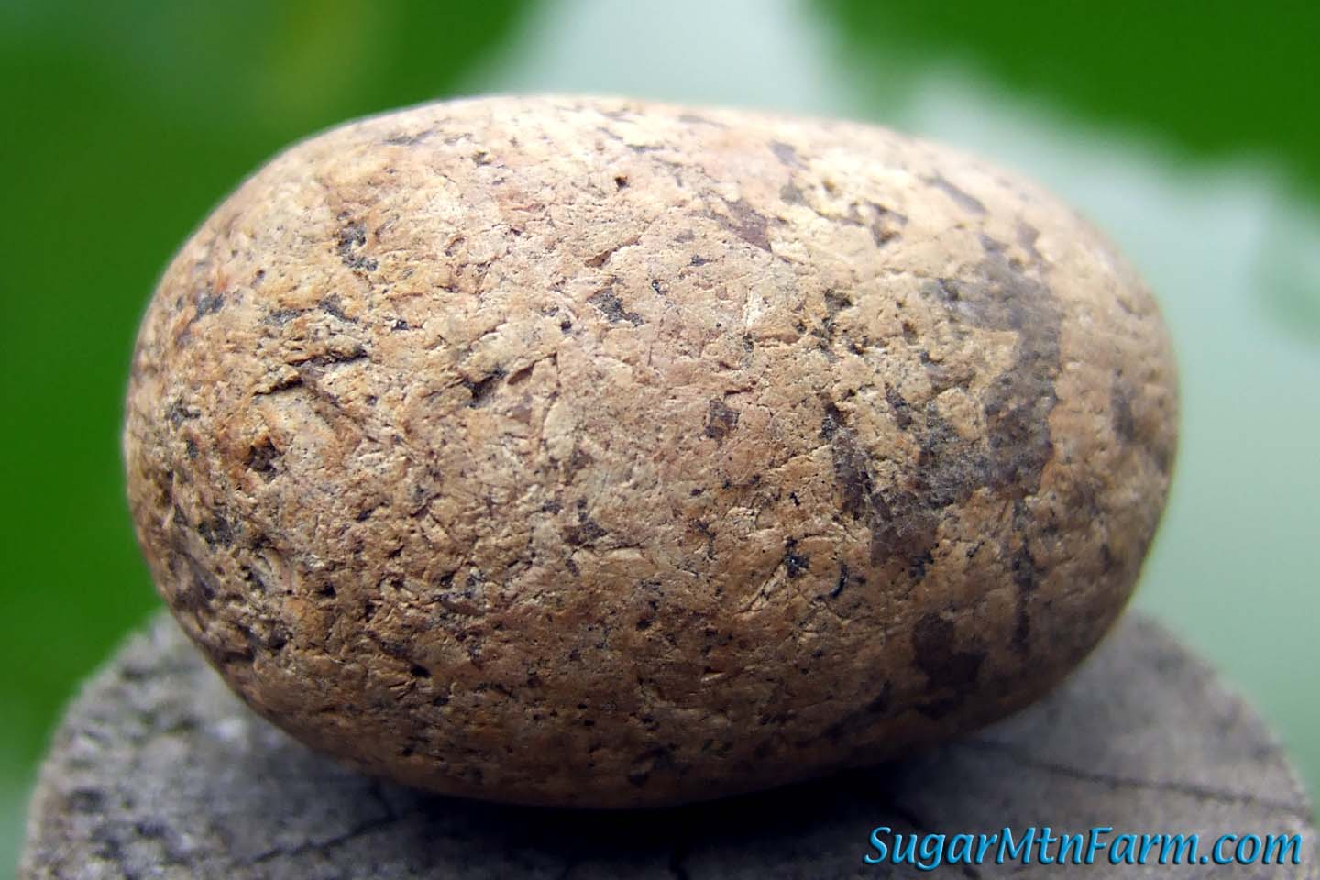
Heated Rock boiling
If you don’t have a container that will withstand the heat of boiling over the heat source you can heat rocks and then place them in your container.
Continue until the water boils for about 5 minutes.

Slide 32
Distillation
This uses the process of condensation to purify water. You boil water in a container and then let the steam or water vapor collect and fall into another container.
This not only kills all organisms because it has been boiled but removes salts and other impurities so it is the best option for sea water or if after boiling the water still tastes bad.
Never drink sea water, it will speed up dehydration

Slide 33
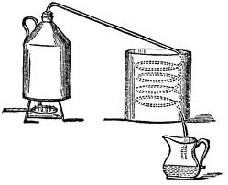

Slide 34
SODIS – Solar Disinfection
This method uses the UV rays of the sun to disinfect the water.
First filter the water
Put water in a smaller clear plastic bottle. 2 liters or less -I collected the Gatorade bottles because they are sturdier than water bottles.
Shake the bottle and then place in the sun. 6 hours of bright sunlight or 2 days if it is cloudy.
Being used in 3rd world countries now

Slide 35
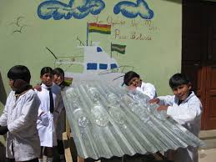
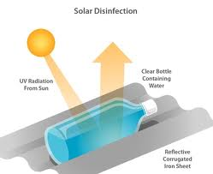
Independence day – he used galvanized steel that was wavy and built an A-frame for it to lean against then put the bottles filled with rainwater in them. His wife was dubious so he had the rainwater, the well water and the UV treated water all tested. Rainwater was worst, then the well water. The UV water was the purist.

Slide 36
Solar Still
Device that allows the sun to heat up the soil and then for any moisture to condense and fall into a container.
Dig a pit about 2-3 feet deep.
Put a container in the bottom.
Cover with a piece of plastic weigh down the edges with the extra dirt
Put a rock in the middle over the container
Some people put a tube from the container out of the plastic so you can suck out the water without disturbing your set up but will work either way.
Sunny days work faster and adding some vegetation to the pit will also help..

Slide 38
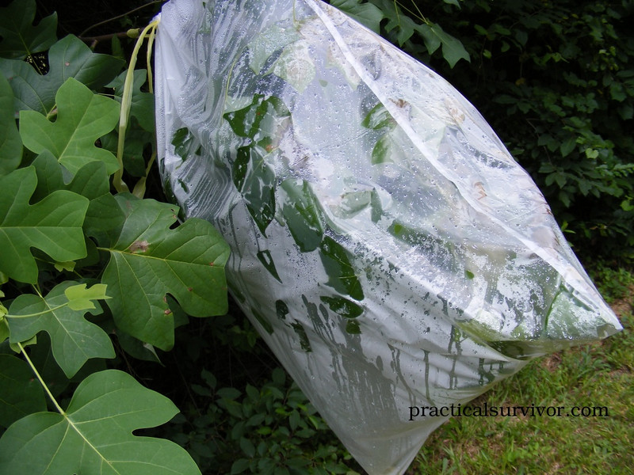
Plant condensations

Slide 39
Pasteurization
Louis Pasteur showed that bacteria are killed at 149* and that is how milk is pasteurized today.
So why do people boil water if they don’t have to? Because they don’t know when it hits 149*.
WAPI or water pasteurization indicator allows you to do that.
These are reusable and inexpensive. Good thing to have in a 72 hour kit as well as your food storage.
And if you are really adventurous you can find instructions on making them yourself.

Slide 40
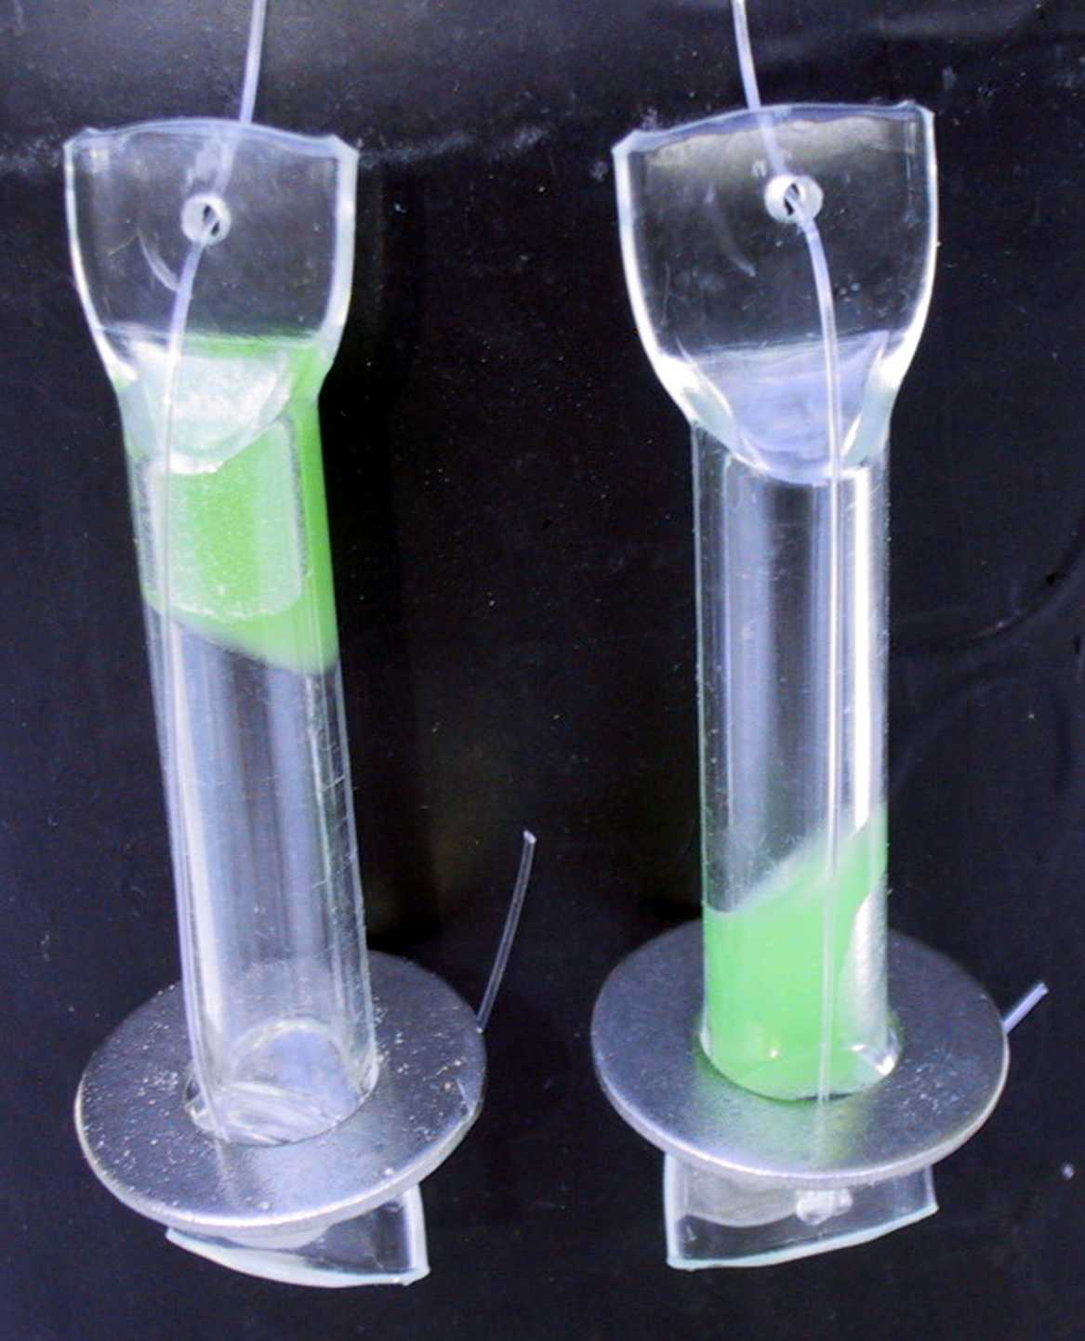

Slide 41
Chemical Additives - Bleach
The 2 most common chemical additives are bleach and iodine but there are a few others.
Bleach –
Never use bleach that has a scent added to it, it will make you sick
8-16 drops per gallon and let sit for at least 30 minutes
There should be a slight bleach scent; if not repeat the process.
If you still don’t get the bleach scent throw it out, it is too contaminated to use
Does not kill all protozoa so can still make you sick

Slide 42
Chemical additives – iodine
Read the label to see how to use it; usually at least 30 minutes.
Light sensitive and must be stored in the dark.
It tastes bad.
The water may still be dirty.
Does not kill cryptosporidium. –a protozoan that causes diarrhea
Not good for people with thyroid problems or pregnant women to use this.

Slide 43
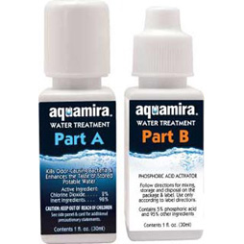
Chemical Additives – Aqua Mira
Chlorine Dioxide or Aqua Mira
This comes in 2 bottles that you mix together. I have seen it available for around $15 to treat 60 gallons of water
Water treated will stay good for about 5 years.
No taste unlike the iodine
Does kill cryptosporidium

Slide 44
Chemical Additives - Tablets
Katadyn Micropur tablets come individually wrapped and each one is good for 1 liter of water. Takes about 4 hours to work.
Coleman Purification tablets get at Walmart for about $6 a package. 2 pills go in and wait 30 minutes then use the PA plus to get rid of the bad taste. Each is good for 1 quart or liter of water.

Slide 45
Calcium Hypochlorite
Dry 68% Calcium Hypochlorite Granules or pool shock
This is dangerous stuff and I would not recommend it.
Be sure you do a TON of research if you want to go this route

Slide 46
Ultra Violet water purification
This is a device you can buy that will emit Ultra Violet light and destroy microorganisms.
No adding chemicals to affect taste or odor
Has a USB rechargeable battery and can be used multiple times
Steripen is one brand I found that will treat 16oz in 48 seconds or 33 oz in 90 seconds
It can be used up to 8,000 times
Found prices from about $50 to $100 for them online
This is meant for small amounts of water at one time.
Good for 72 hour kits.

Slide 47
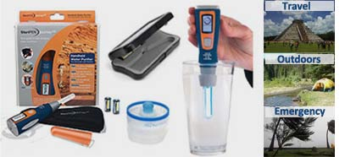

Slide 48
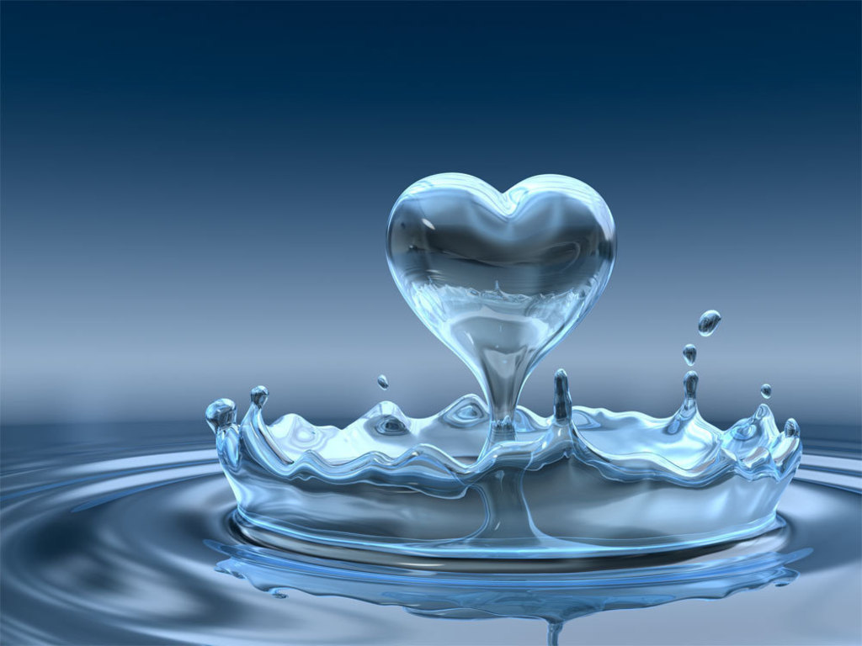
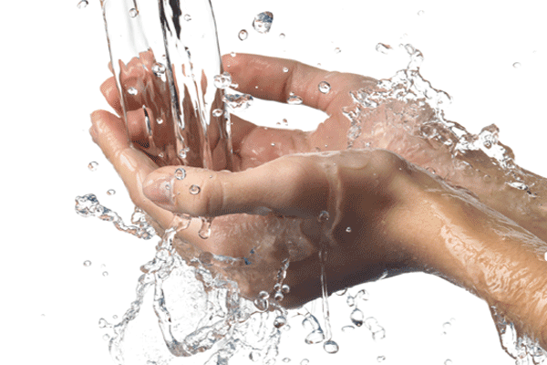
Water is vital for our survival
Learn how to store and purify water so your family will not suffer in hard times whether short or long term.
If you don’t you will spend 90% of your time trying to find water for them.
Water is one of the cheapest things to store but it takes a lot of space so store what works for your space.

