Slide 1
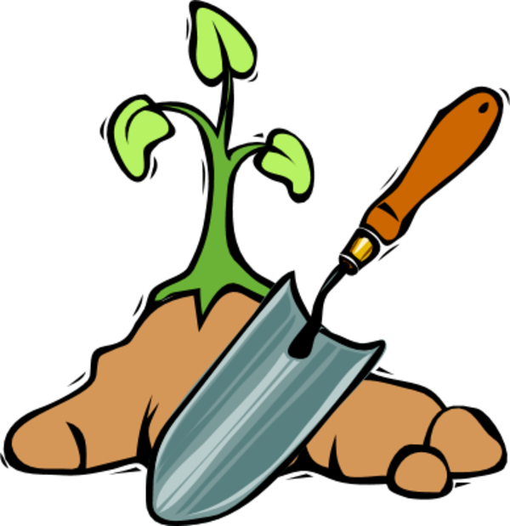
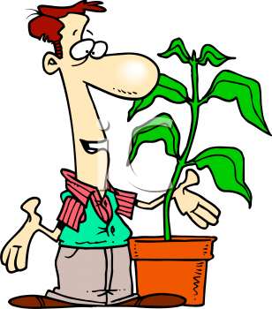
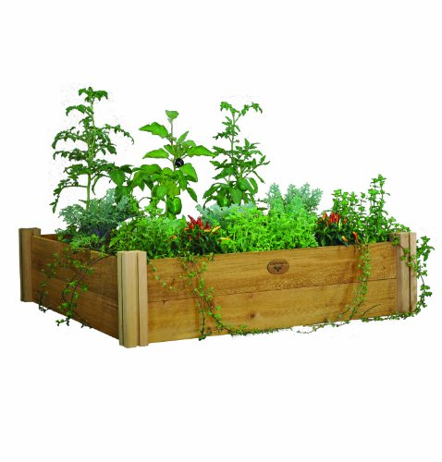
Vegetable Gardening 101

Slide 2
What Type of Gardner Are You ?
New to Gardening
Don’t Have a Green Thumb
Can’t Stand Bugs
New to Texas
Have a Bad Back or Physical Limitations

Slide 3
What Type of Space Do You Have?
Small Yard
No Yard
Lots of Concrete
Lots of Shade – Minimal Sun
All Day Sun
Rent

Slide 4
This Photo by Unknown Author is licensed under CC BY-NC-ND

Slide 5
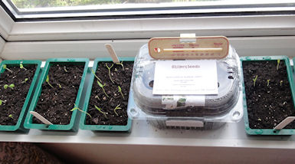
Window Sill Gardening
This Photo by Unknown Author is licensed under CC BY-NC-ND
This Photo by Unknown Author is licensed under CC BY-NC-ND

Slide 6
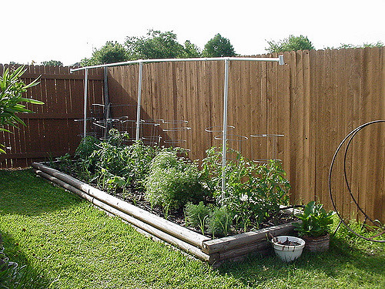
Back Yard Garden

Slide 7
Looking to Make it a Family Event

Slide 8
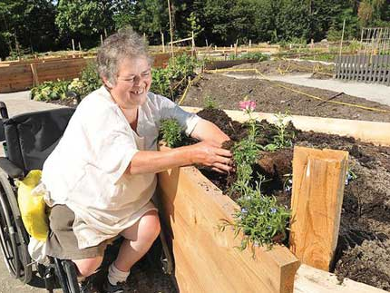
As an Individual
In a Community Setting
This Photo by Unknown Author is licensed under CC BY-SA-NC

Slide 9
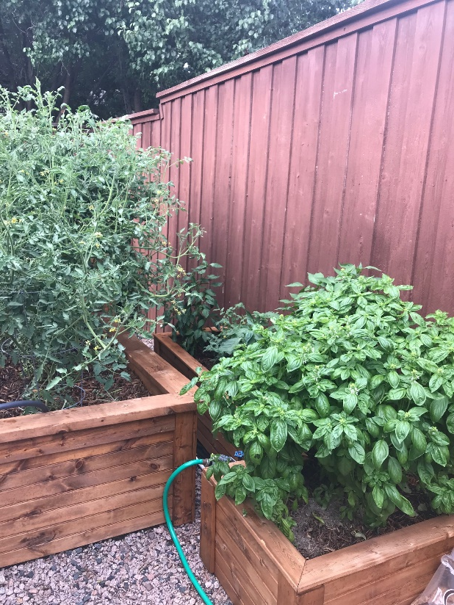
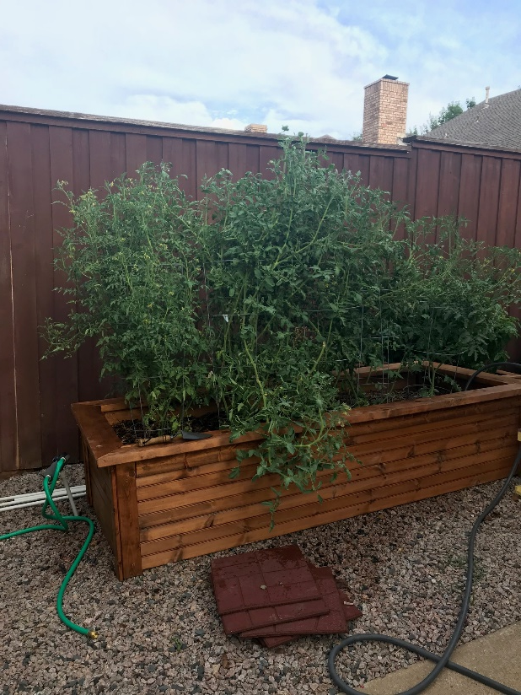
Summer Garden

Slide 10
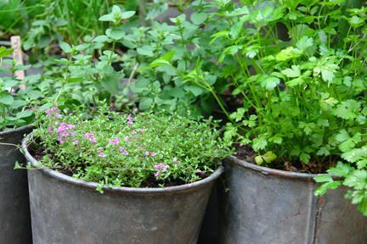
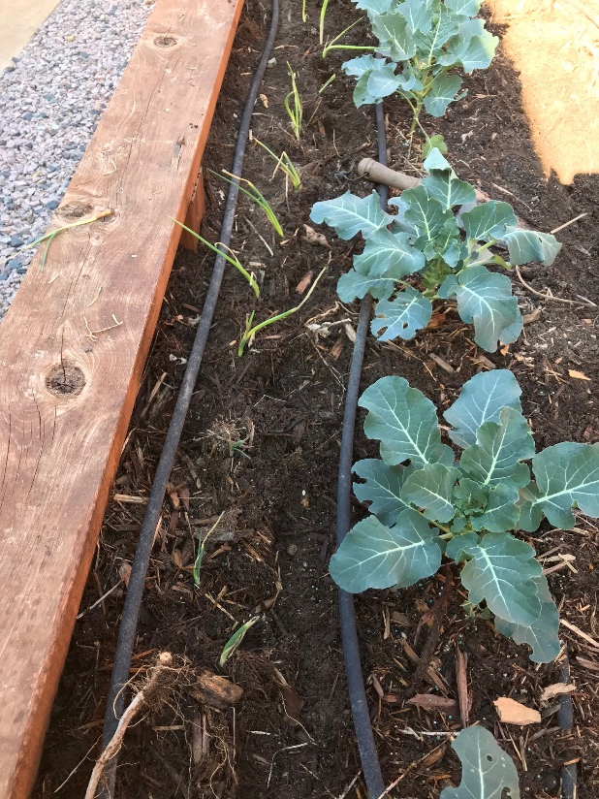
Winter Garden

Slide 11
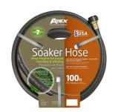
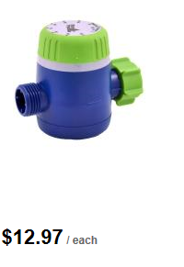
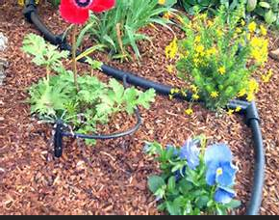
Watering

Slide 12
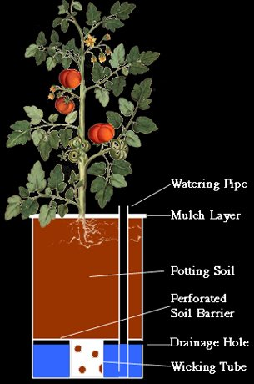
Different Types of Garden Containers & Structures

Slide 13
Bales of Straw

Slide 14
Sack or Cloth Bag

Slide 15
Bag of Dirt

Slide 16
Raised Beds

Slide 17
Raised Bed

Slide 18
Question: I don’t have a lot of sunlight in my yard. How much will I need to grow vegetables?
Most flowering and fruiting vegetables will need at least 6 to 8 hours of direct mid-day sunlight to yield well. Horticulturally, we’d call that “full or nearly full sun.”
Leaf and root crops can get by with less direct sunlight, but, again, the less light they get, the poorer the yields will be.

Slide 19
Question: How often do I need to fertilize the garden?
If you’re using a quality granular material, probably just once a month through harvest
A water-soluble fertilizer, you’ll probably need to apply it once a week.
Organic fertilizers break down much more slowly, so just two or three applications per season will be needed, about every 4 to 6 weeks.

Slide 20
Question: What are the easiest crops for a home vegetable garden?
First, start with types your family really likes. It doesn’t matter if they’re easy. If the family hates them, you’re wasting your time, space and effort.
Easiest- cabbage, broccoli, radishes, leaf lettuce, potatoes, squash, beans, cucumbers, tomatoes, peppers, okra and southern peas.

Slide 21
Question: Is it necessary that I mulch my garden?
In Texas- YES
It keeps the produce off the soil surface limiting rotting
Helps deter insect and disease invasion.
Reduces splashing, so your produce is cleaner when you bring it indoors .
Limits weed growth
Help moderate soil temperature change
Lessens water and soil run off . Conserves moisture .

Slide 22
Question: My melon leaves have a white powder on them. Will it hurt the plants?
That’s powdery mildew. It can weaken the plants, so, if the problem seems severe, you can use a labeled fungicide. Keep irrigation water off the leaves, and don’t handle the plants while the leaves are wet.

Slide 23
Know your Zone

Slide 24
Frost Dates
Each winter, on average, your risk of frost is from November 13 through March 20.Almost certainly, however, you will receive frost from December 1 through February 28.
You are almost guaranteed that you will not get frost from April 10 through October 29.
Your frost-free growing season is around 238 days.

Slide 25
Best Fall Vegetables
Lettuce (can be finicky)
Squash (easy)
Broccoli (easy)
Swiss Chard (easy)
Onions (easy)
Garlic (easy)
Spinach (intermediate)
Cauliflower (intermediate)
Cabbage (intermediate)
Beans / Peas (intermediate)

Slide 26
Best Spring – Summer Vegetables
Tomatoes (easy)
Peppers (easy)
Corn (need space)
Potatoes (easy)
Herbs (easy)
Asparagus (easy, but need permanent space)
Onions (easy)
Garlic (easy)
Melons (need space)
Berries (need space)

Slide 27
Preventing Disease
Choose resistant or tolerant varieties.
Buy treated seed.
Make sure seeds, transplants, and propagating material are disease-free.
Choose a sunny, well-drained location
Improve the soil
Water plants carefully.

Slide 28
Preventing Disease
Don't over- or under-fertilize
Space plants to allow air circulation
Clean up debris
Rotate crops.

Slide 29
Question: When are vegetable transplants better than planting seeds?
Plants that have smaller seeds will often be better as transplants.
If the seed is very expensive, you’ll want to use transplants
How much patience do you have? Transplants will give you a jump start.
Vegetables we most commonly plant from transplants include onions, cabbage, broccoli, cauliflower, Brussels sprouts, tomatoes, peppers, eggplants and sweet potatoes.

Slide 30
Question: Can I grow head lettuce successfully in Texas?
Not easily. You’re much better off planting leaf types. Use several varieties of green- and red-leafed lettuce for an extended season and for the prettiest salads.

Slide 31
Question: My lettuce isn’t sweet, but very bitter. What causes that?
Hot, dry weather will cause lettuce to be bitter.
If you plant the seeds too late in the spring, the plants will mature too late.
If you cut several harvests of lettuce, then leave the plants in the garden too long, they’ll get tough and strong-flavored.
Fall lettuce often has a sweeter flavor, since the leaves are growing during more favorable temperatures.

Slide 32
Question: I’m growing the recommended varieties of tomatoes, but even they aren’t setting fruit. What gives?
Assuming they’re in full sunlight and are producing flowers, then they probably aren’t getting pollinated.
Tomato flowers are self-pollinating, and it’s the action of the wind that vibrates the pollen loose within the flowers.
If you’re growing your tomatoes in a sheltered area, and if they’re not exposed to much wind motion, you may have to thump the flower clusters with your finger every couple of days to ensure good pollination.

Slide 33
Question: My squash plants’ leaves are tan and dead. It started with the bottom leaves.
That sounds like spider mite damage.
They will cause tiny tan specks all over the leaves, usually showing up in late May and June.
Spider mites are the most damaging vegetable garden pests that we have.
As the problem gets worse the leaves eventually turn brown and crisp.
Control them as soon as you see the first mottling by spraying with a labeled insecticide.

Slide 34
Question: How well will I do growing watermelons in a home garden?
Watermelons take large amounts of garden space, often as much as 100 square feet per plant. Grow them only if you can give them that room to grow.
Plant them a week or two after the last killing freeze date for your area.
Watermelons are not as productive in fall gardens. They really prefer the hot days of early summer.

Slide 35
Question: Why are my tomato plants’ leaves turning yellow from the ground upward?
When the leaves develop yellow thumbprint-sized blotches it’s a fungal disease called early blight.
Apply a general-purpose fungicide that is labeled for tomatoes.
Spray at first evidence of the disease, generally in late May in South Texas and early June in North Texas.

Slide 36
Question: When should I plant my tomatoes?
This is where most folks fall down on the job. Spring tomatoes should be planted around the date of the last killing frost.
Earlier plantings often get frozen, and later plantings run into the summer heat. You have a 2- or 3-week window in most of Texas.
Fall plantings need to be timed back from the first expected frost. Allow 4-1/2 months from planting until the average first frost date - late June in North Texas.
The fall crop will be the better crop, so don’t miss the opportunity. Those fruit will ripen without all the traditional problems of the spring tomato planting.

Slide 37
Question: Nursery tomato transplants that are available are often too tall and lanky. Can they still be used? Also, is it better to buy tough transplants that have been grown in cooler weather outdoors, or the more succulent, vigorous-looking ones I find in greenhouses?
You can use those tall transplants, but lay them angled on their sides in trenches in the garden. They will form roots all along their stems.
Always buy the toughened transplants. They’ll re-establish much more quickly than the succulent plants that may suffer wind burn or sunscald when they get introduced to the realities of Texas weather.

Slide 38
Question: My tomato plants’ leaves are cupped and rolled. Is that a disease? There are no other symptoms, and they seem to keep producing fruit.
When the temperatures climb above 90 degrees in late May and June, tomato plants respond by rolling their leaves. It makes the plants look odd, but it does nothing to the fruit that is on the plants. It will usually start with the bottom leaves.
Some tomato varieties will drop their blossoms and not set when its over 90 degrees

Slide 39
Question: Can I plant tomatoes in containers and hope to expect any good production? Are some varieties better than others? What size of container should I use, and what type of potting soil?
Tomatoes are very well adapted to container gardens. Use at least a 5-gallon, preferably a 7- or 10-gallon container and a loose, highly organic potting soil (no native soil, please).
If possible, use “determinate” varieties. They grow to a manageable height, then quit getting any taller. You’ll still want a cage for support.

Slide 40
Question: Can I use potatoes from the grocery store as my starts?
Answer: Buy only certified “seed” potatoes from nurseries and farm stores. These are intended for garden planting and have not been treated with chemicals to retard sprouting. Cut the seed potatoes into several sections, each with at least one “eye.” That will become the growing stem of the new plant.

Slide 41
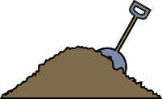
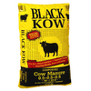
Dirt

Slide 42
Building Healthy Soil
Soil is composed of weathered rock and organic matter, water and air. But the hidden "magic" in a healthy soil is the organisms—small animals, worms, insects and microbes—that flourish when the other soil elements are in balance.
Minerals..
Soil type is generally classified by the size of these inorganic soil particles: sand (large particles), silt (medium-sized particles) or clay (very small particles). The proportion of sand, silt and clay particles determines the texture of your soil and affects drainage and nutrient availability, which in turn influence how well your plants will grow.

Slide 43
Best soil mixture
Raised beds and containers
Mixture of 50% screened topsoil and 50% high-quality compost. These two ingredients should be mixed together well (not layered
Mel’s Mix is (by volume) 1/3 coarse horticultural vermiculite, 1/3 peat moss, and 1/3 blended compost.

Slide 44
Mulch
Cedar Mulch
1 to 2 inches
Wood Barks
Other types
Peat Moss
Leaves
Grass Cuttings
Biodegradable covers or sheets

