Slide 2
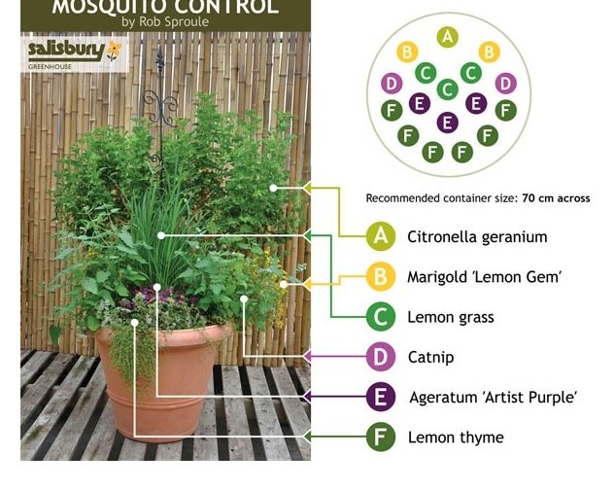
Mosquito Planter

