Slide 1
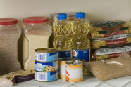
Be Ready with Home Storage
The 2014 Plano Stake Preparedness Challenge:

Slide 2
Why Store FooD?
A disruption in our supply system could mean no food will be available on grocery shelves
Drought and other natural disasters
Food supply may become contaminated
Loss of job or family income
Peace of mind
Our Prophets have asked us to

Slide 3
The enemies of food storage
Oxygen
Heat
Humidity
Light
Pests

Slide 4
How To Store Food
Dry Pack Canning
Mylar Pouches
Vacuum Sealing (e.g. Food Saver)
Dehydrating
Bottling
Buy Food Already Packaged for Storing

Slide 5
Where To Store Food

Slide 6
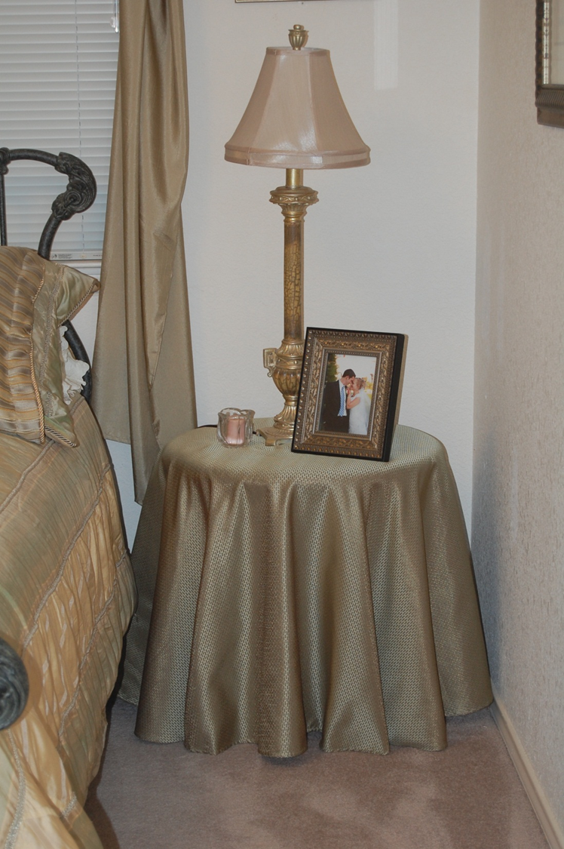

Slide 7
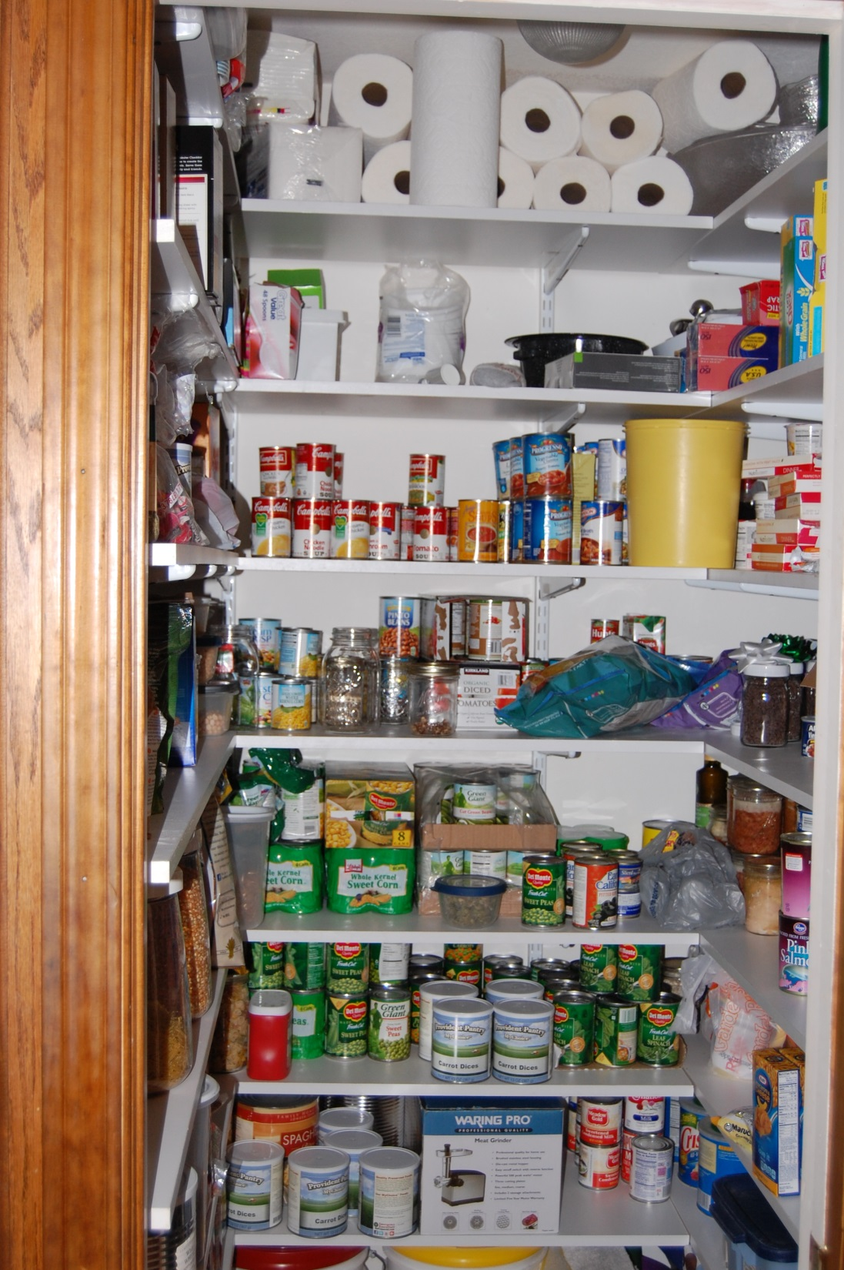

Slide 8
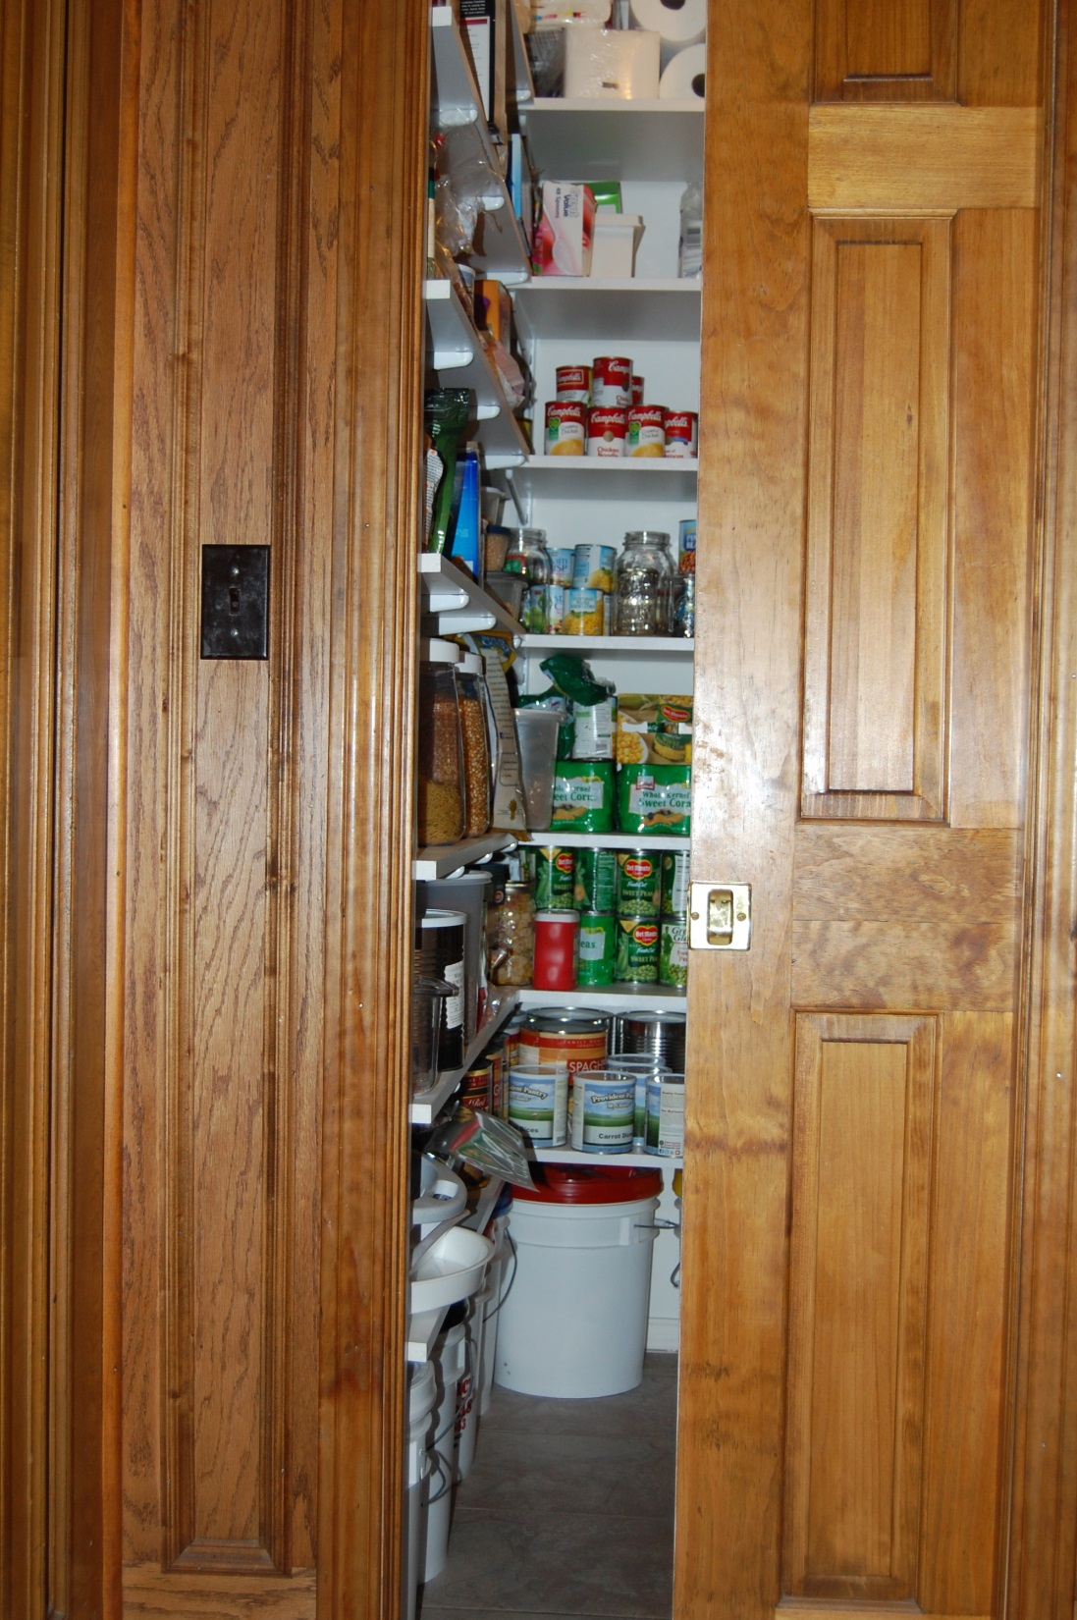

Slide 9
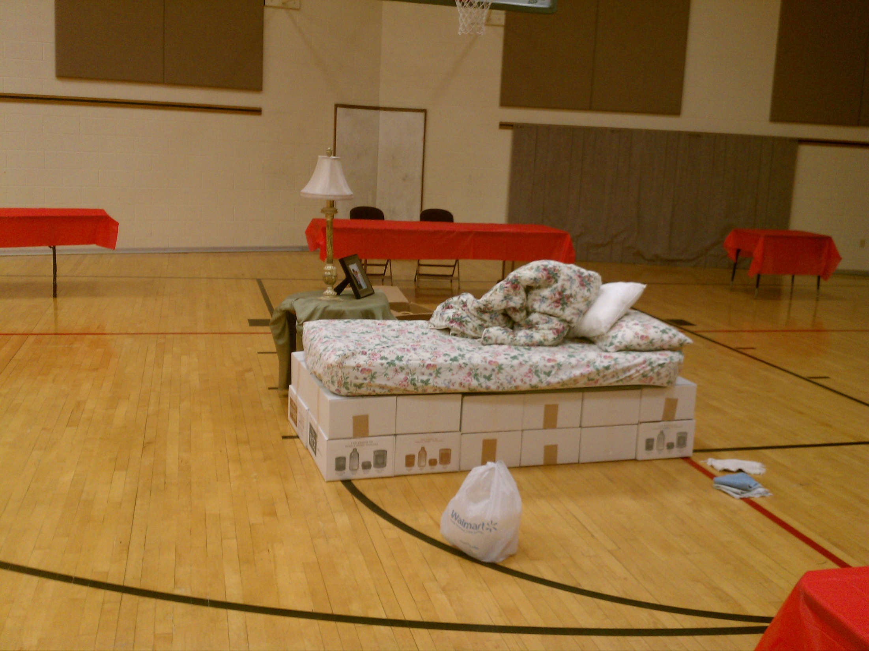

Slide 10
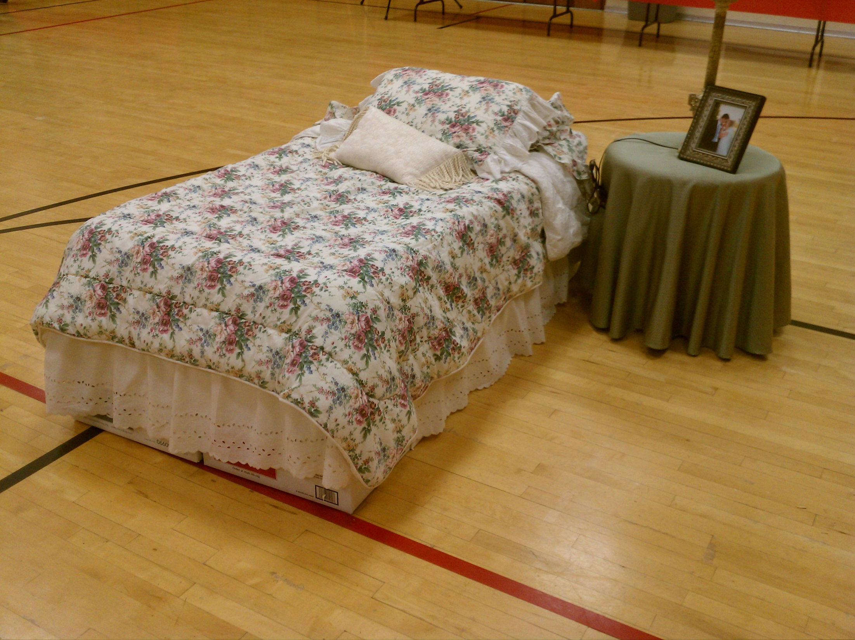

Slide 11
What should we store?
Three Month Food Supply of what your family is used to eating
Keep track of what you eat for one or two weeks
Use your record to make a menu
Use your menu to make a shopping list
Buy wisely

Slide 12
Longer term storage
Wheat
Oats
White Rice
Legumes
Milk
Sweeteners
Fats
Baking Ingredients

Slide 13
Sprouting:

Slide 14
Non Food Items
Hygiene supplies
Toilet paper
Cleaning supplies
Laundry supplies
Paper goods
Tin foil, plastic wrap, storage bags, garbage bags,etc.
Emergency sources of light
Emergency sources of fuel

Slide 15
Diversify
Storing food in a variety of ways (canned, frozen, dried, etc.) is a good idea. If one way is damaged, you have others to fall back on.

