Slide 1
Be Ready for
Emergencies
The 2014 Plano Stake Preparedness Challenge

Slide 2
What are our possible emergencies?
Tornadoes
Ice Storms
House fires or wildfires
Power outages
Water supply contamination or shortages
Transportation or supply disruption
Civil unrest
Nuclear, chemical or biological warfare
Pandemic illnesses

Slide 3
What can we do to prepare?
Store Water
Store Food
Store Fuel
Have emergency evacuation or 72 hour kits
Have a first aid kit and know basic first aid
Copy important and legal documents
Make a home inventory
Have an emergency escape plan
Have an emergency communication plan

Slide 4
Most of all—HAVE A PLAN
Prayerfully ask the Lord to guide you in formulating a preparedness plan for your family.
Your goal--Maintain your family’s:
Health
Safety
Self-sufficiency

Slide 5
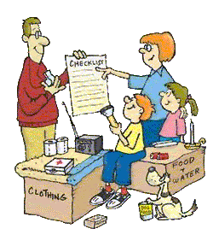
Involve Your
Family in
Emergency
Preparedness

Slide 6
Plan to stay safe at home
Know where to go in the home if a tornado is imminent
Have a rehearsed plan as to how to escape the home in case of a house fire,
Have Smoke Alarms and CO Monitors
Have charged fire extinguishers handy
Keep Baking Soda handy in the kitchen
Know how to turn off gas and water (if gas is turned off, a plumber must turn it back on)

Slide 7
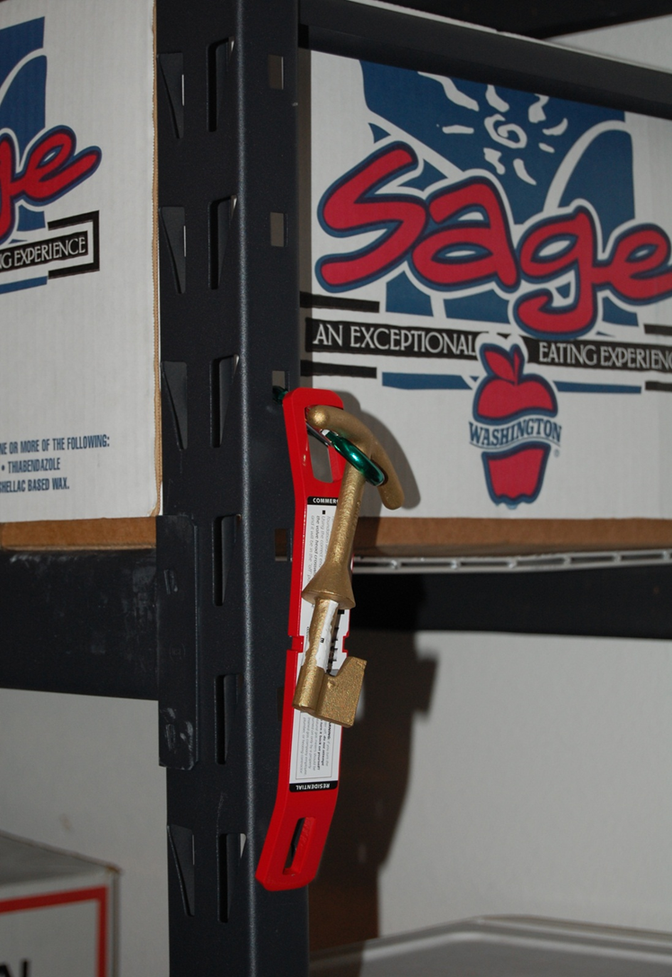

Slide 8
If Family Members Are Away From Home
Consider communication, where to meet, etc.
Go over how to stay safe in buildings, cars, etc.
Teach children to follow school personnel if a disaster happens while they are in school
Help children memorize parent’s phone numbers
Know your company’s emergency plan for the workplace
Identify and know escape routes at work.
Consider having an Emergency Kit for work.
Give trusted co-workers emergency contact information.

Slide 9
Your 72 Hour Kit
Water
Food
First Aid Kit
Shelter
Sleeping Bags
Clothing
Hygiene
Light and Fuel
Equipment and tools

Slide 10
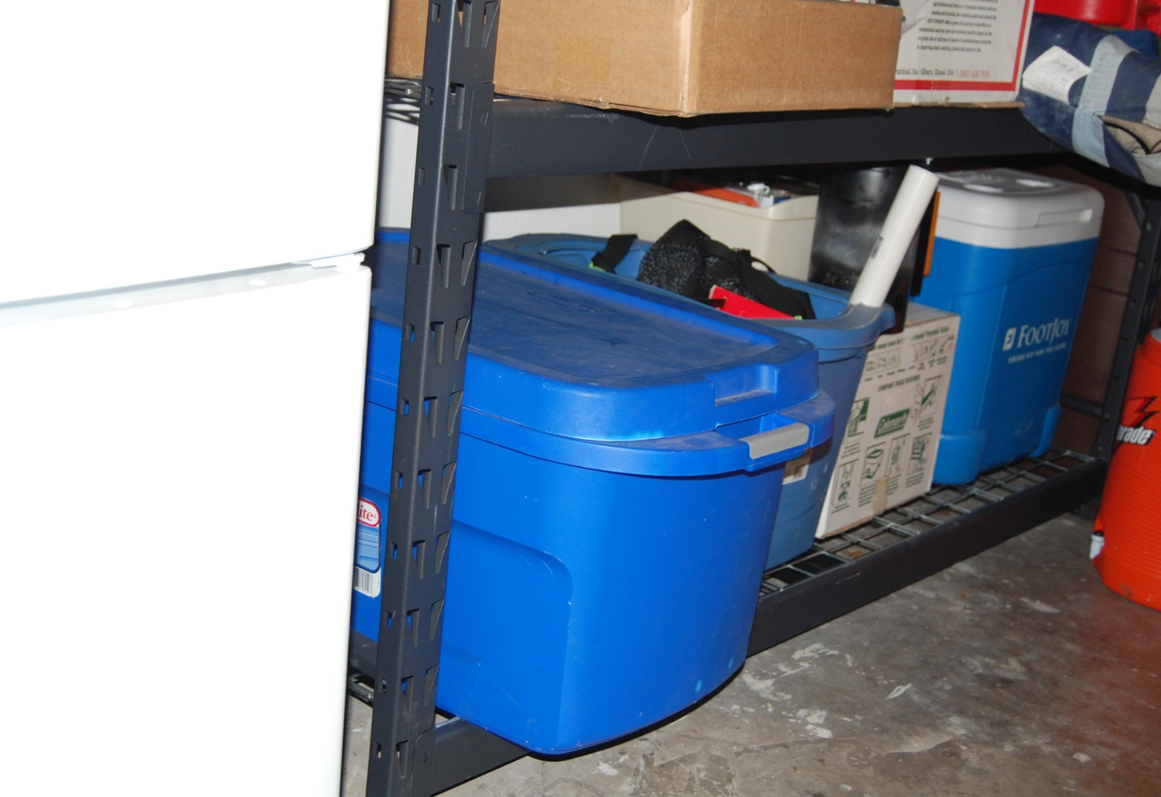
Grab and Go Container in Garage

Slide 11
Other items for 72 hr. kits
Money
Boredom Busters
Permanent marker
Documents
Medical records
Have a current picture of each family member in your 72 Hr. kits

Slide 12
Other Kits:
First Aid Kit
Car Emergency Kit
Work Emergency Kit

