Slide 1
Be Ready
Implementing the temporal part of
The 2014 Plano Stake
Preparedness Challenge

Slide 2
Be Ready with Water Storage and Purification
Much of the information in this presentation
was obtained from Duana Blakey

Slide 3
Why Store Water?
Natural disasters
Water pipelines break
Water treatment plant fails
No electricity for water pumps to work
Contaminations from some source
Civil Unrest
Dam breaks – accidental or terrorism
Drought
The Prophets have asked that we do.

Slide 4
How Much Water Do I Store?
Minimum 1 gallon/person/day (more if infants and small children or special health needs)
FEMA is now saying 2 weeks (instead of 72 hours) for taking care of yourself – food and water

Slide 5
How to Store Water
Use ONLY food grade containers with a PETE or PET recycle symbol (providentliving.org)
Don’t use milk jugs
Store in a variety of sized containers
Water from a chlorinated municipal water supply does not need further treatment (providentliving.org)
Opaque containers work best
Containers should be emptied and refilled regularly

Slide 6
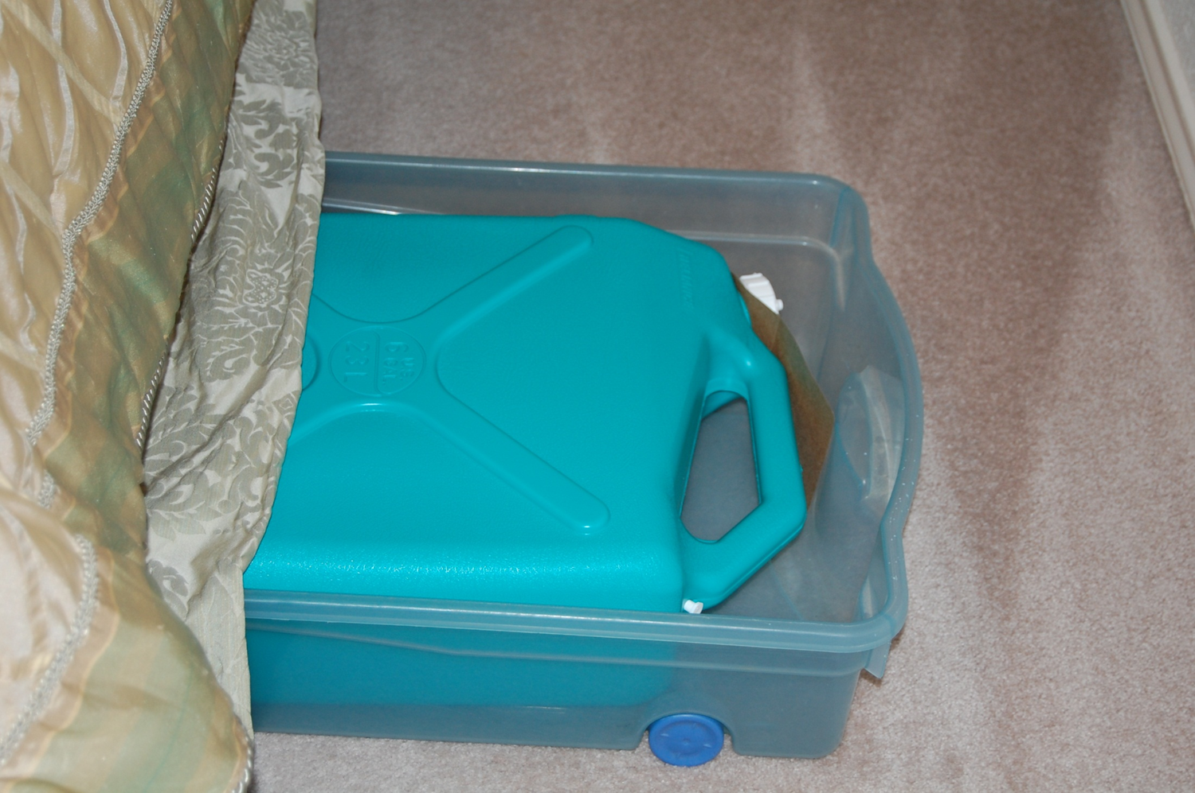

Slide 7
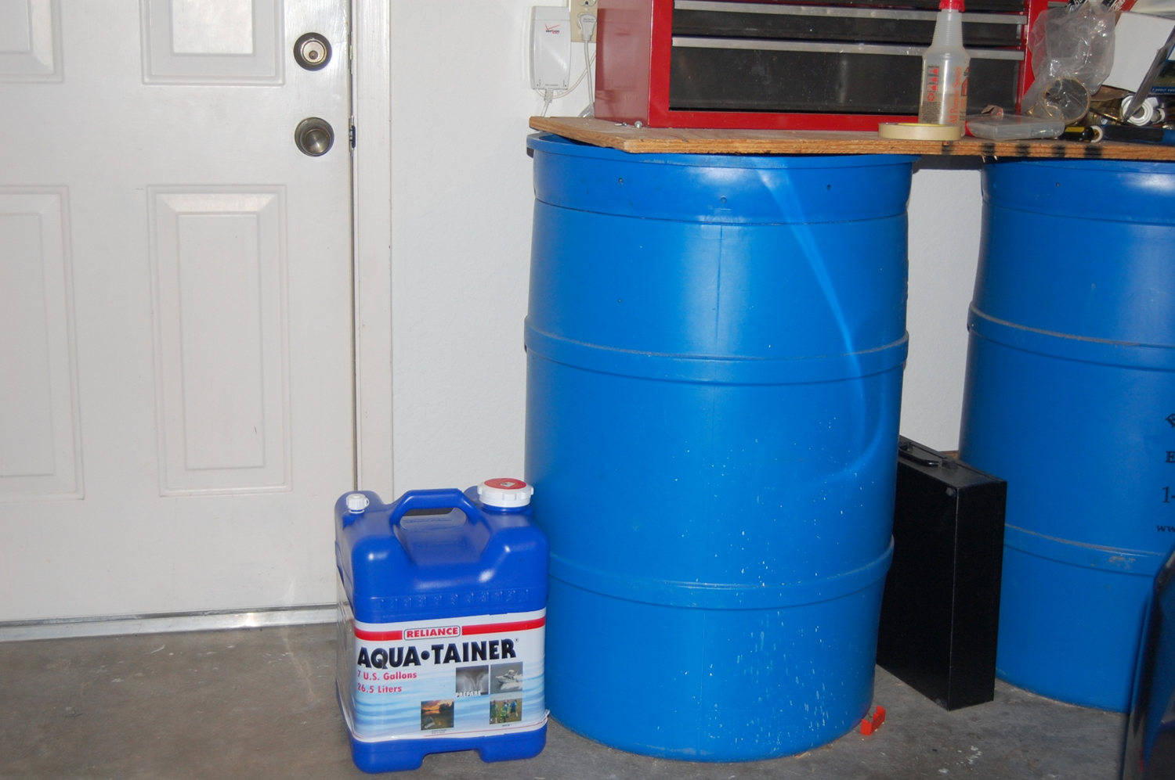

Slide 8
Why Treat Water?
Contaminated water can cause severe problems including:
Severe and prolonged diarrhea
Diseases like cholera and typhoid
Parasites such as giardia and cryptosporidium
Toxins in the water
You should always purify any water that does not come from a water treatment plant

Slide 9
Water Treatment
Filtration
Boiling
Pasteurization
Distillation
MIOX
Chemical
UV (Steri Pen)
Solar

Slide 10
